Slide 1

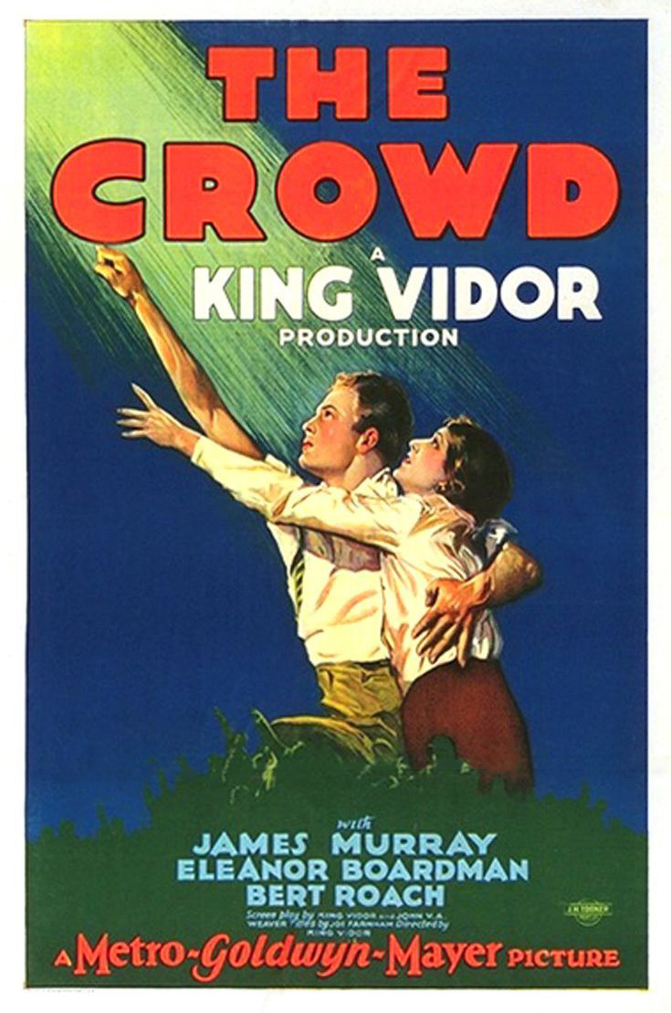
The Crowd
King Vidor
1928
A prescient family drama about navigating love and survival in a city that never stops.

Slide 2
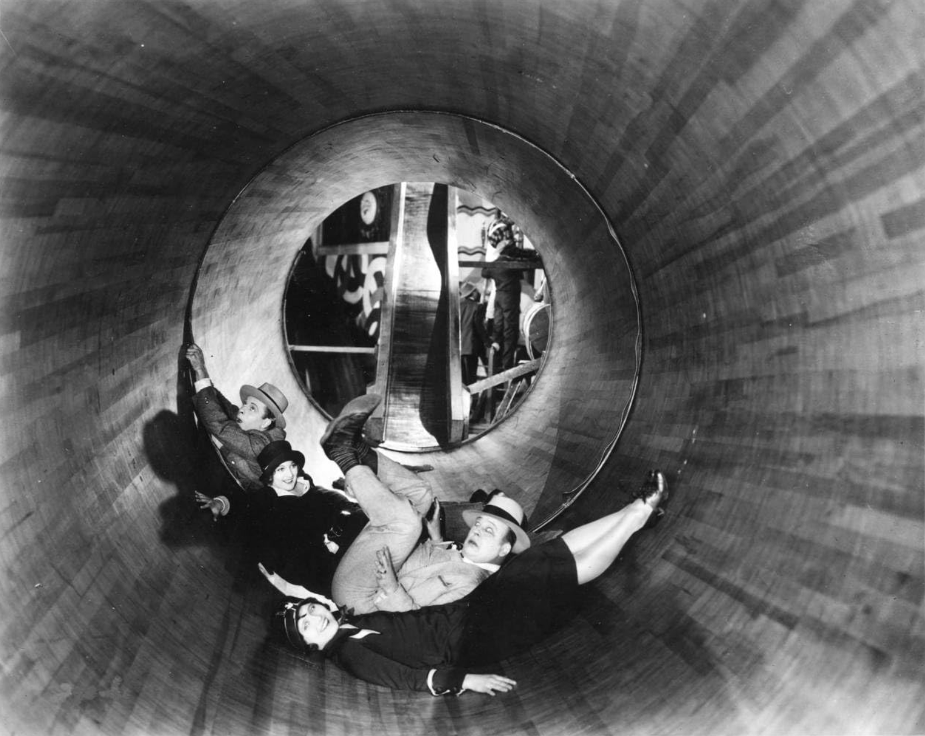
King Vidor began working on The Crowd after the success of The Big Parade, 1925’s highest grossing film.
Vidor aimed to stretch the boundaries of what was possible in silent cinematography. Due to the clunkiness of early sound equipment, innovations made in The Crowd would not be matched for several years.

Slide 3
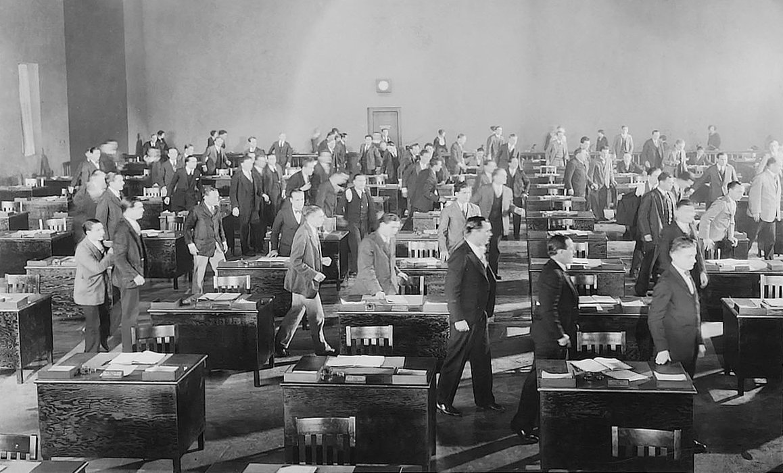
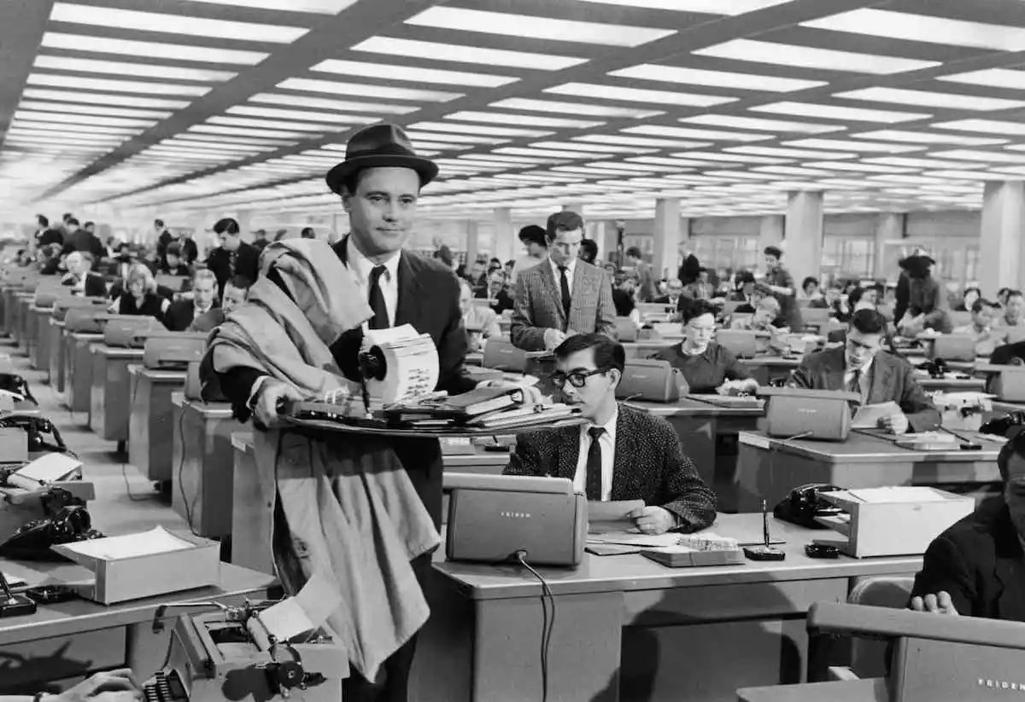
The imagery of the endless desks at John’s office has been replicated several times, most famously in Billy Wilder’s 1960 classic The Apartment.

Slide 4
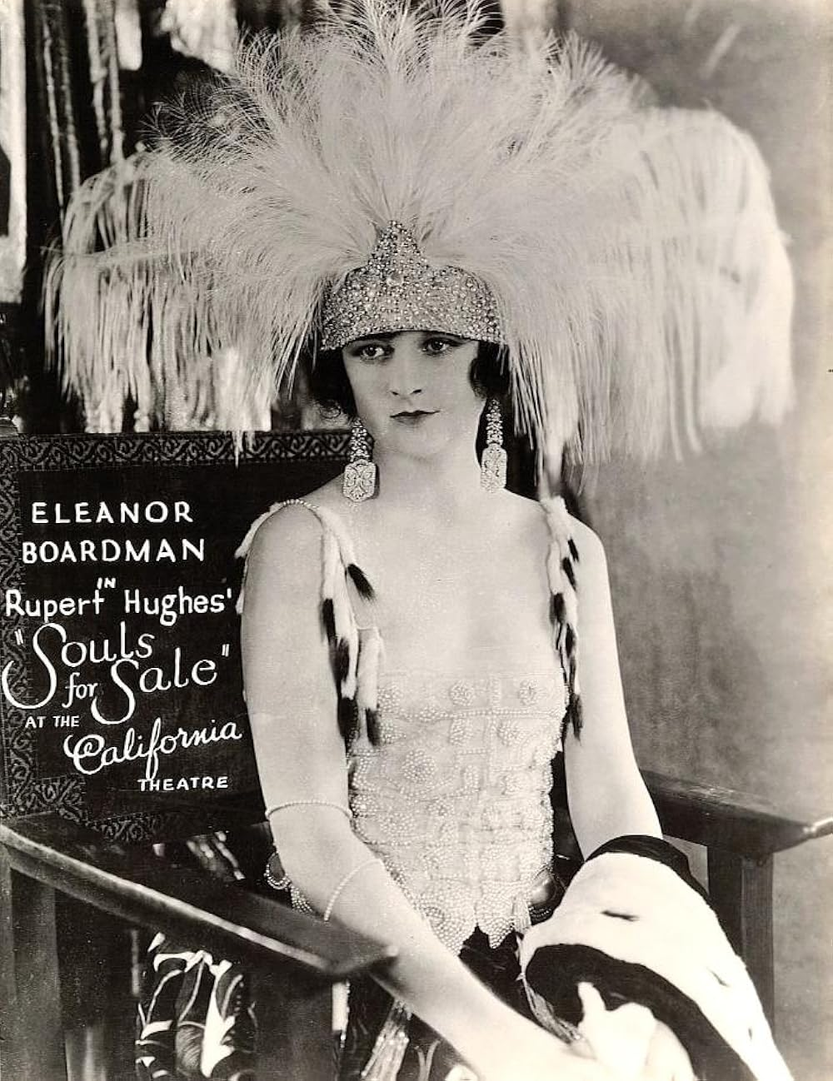
Co-starring as Mary is Eleanor Boardman,Vidor’s wife at the time. This was their sixth and final collaboration.
Despite her brilliant performance in The Crowd, Boardman’s final film in Hollywood would come just three years later. She would retire from acting in 1935 after starring in a Spanish film directed by her second husband, Harry d'Abbadie d'Arrast.

Slide 5
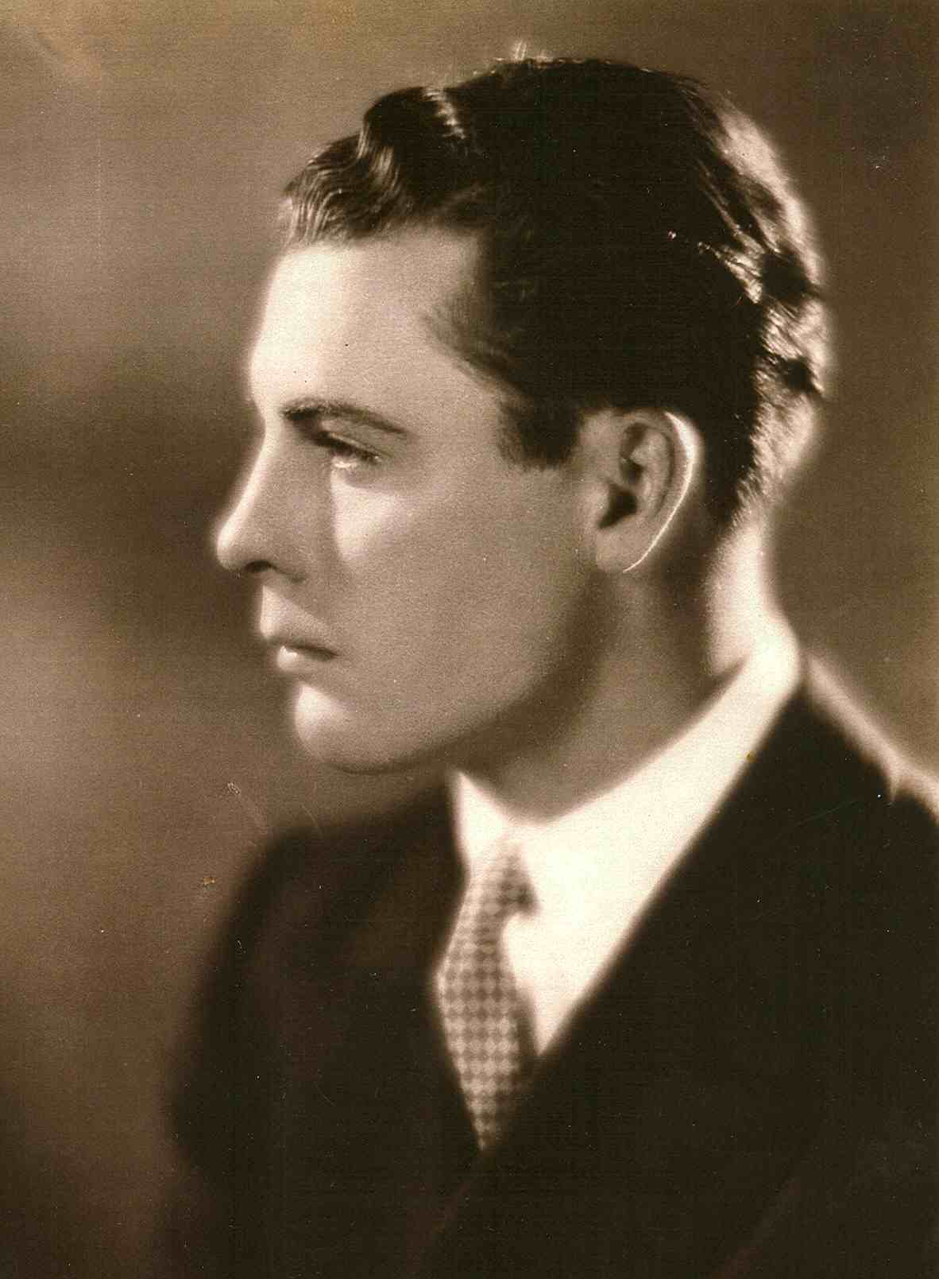
The film stars James Murray as John. Vidor was looking for an unknown for the everyman protagonist when he saw Murray walking past him on the studio lot with a group of extras. After eventually tracking the actor down, he was given the part.

Slide 6

Murray would experience success after the film’s release, but his career faltered due to alcoholism. He would be offered the chance to reprise his role of John in 1934’s Our Daily Bread in exchange for getting clean but rejected the offer.
Tragically, he would die two years later in a drowning accident.

Slide 7
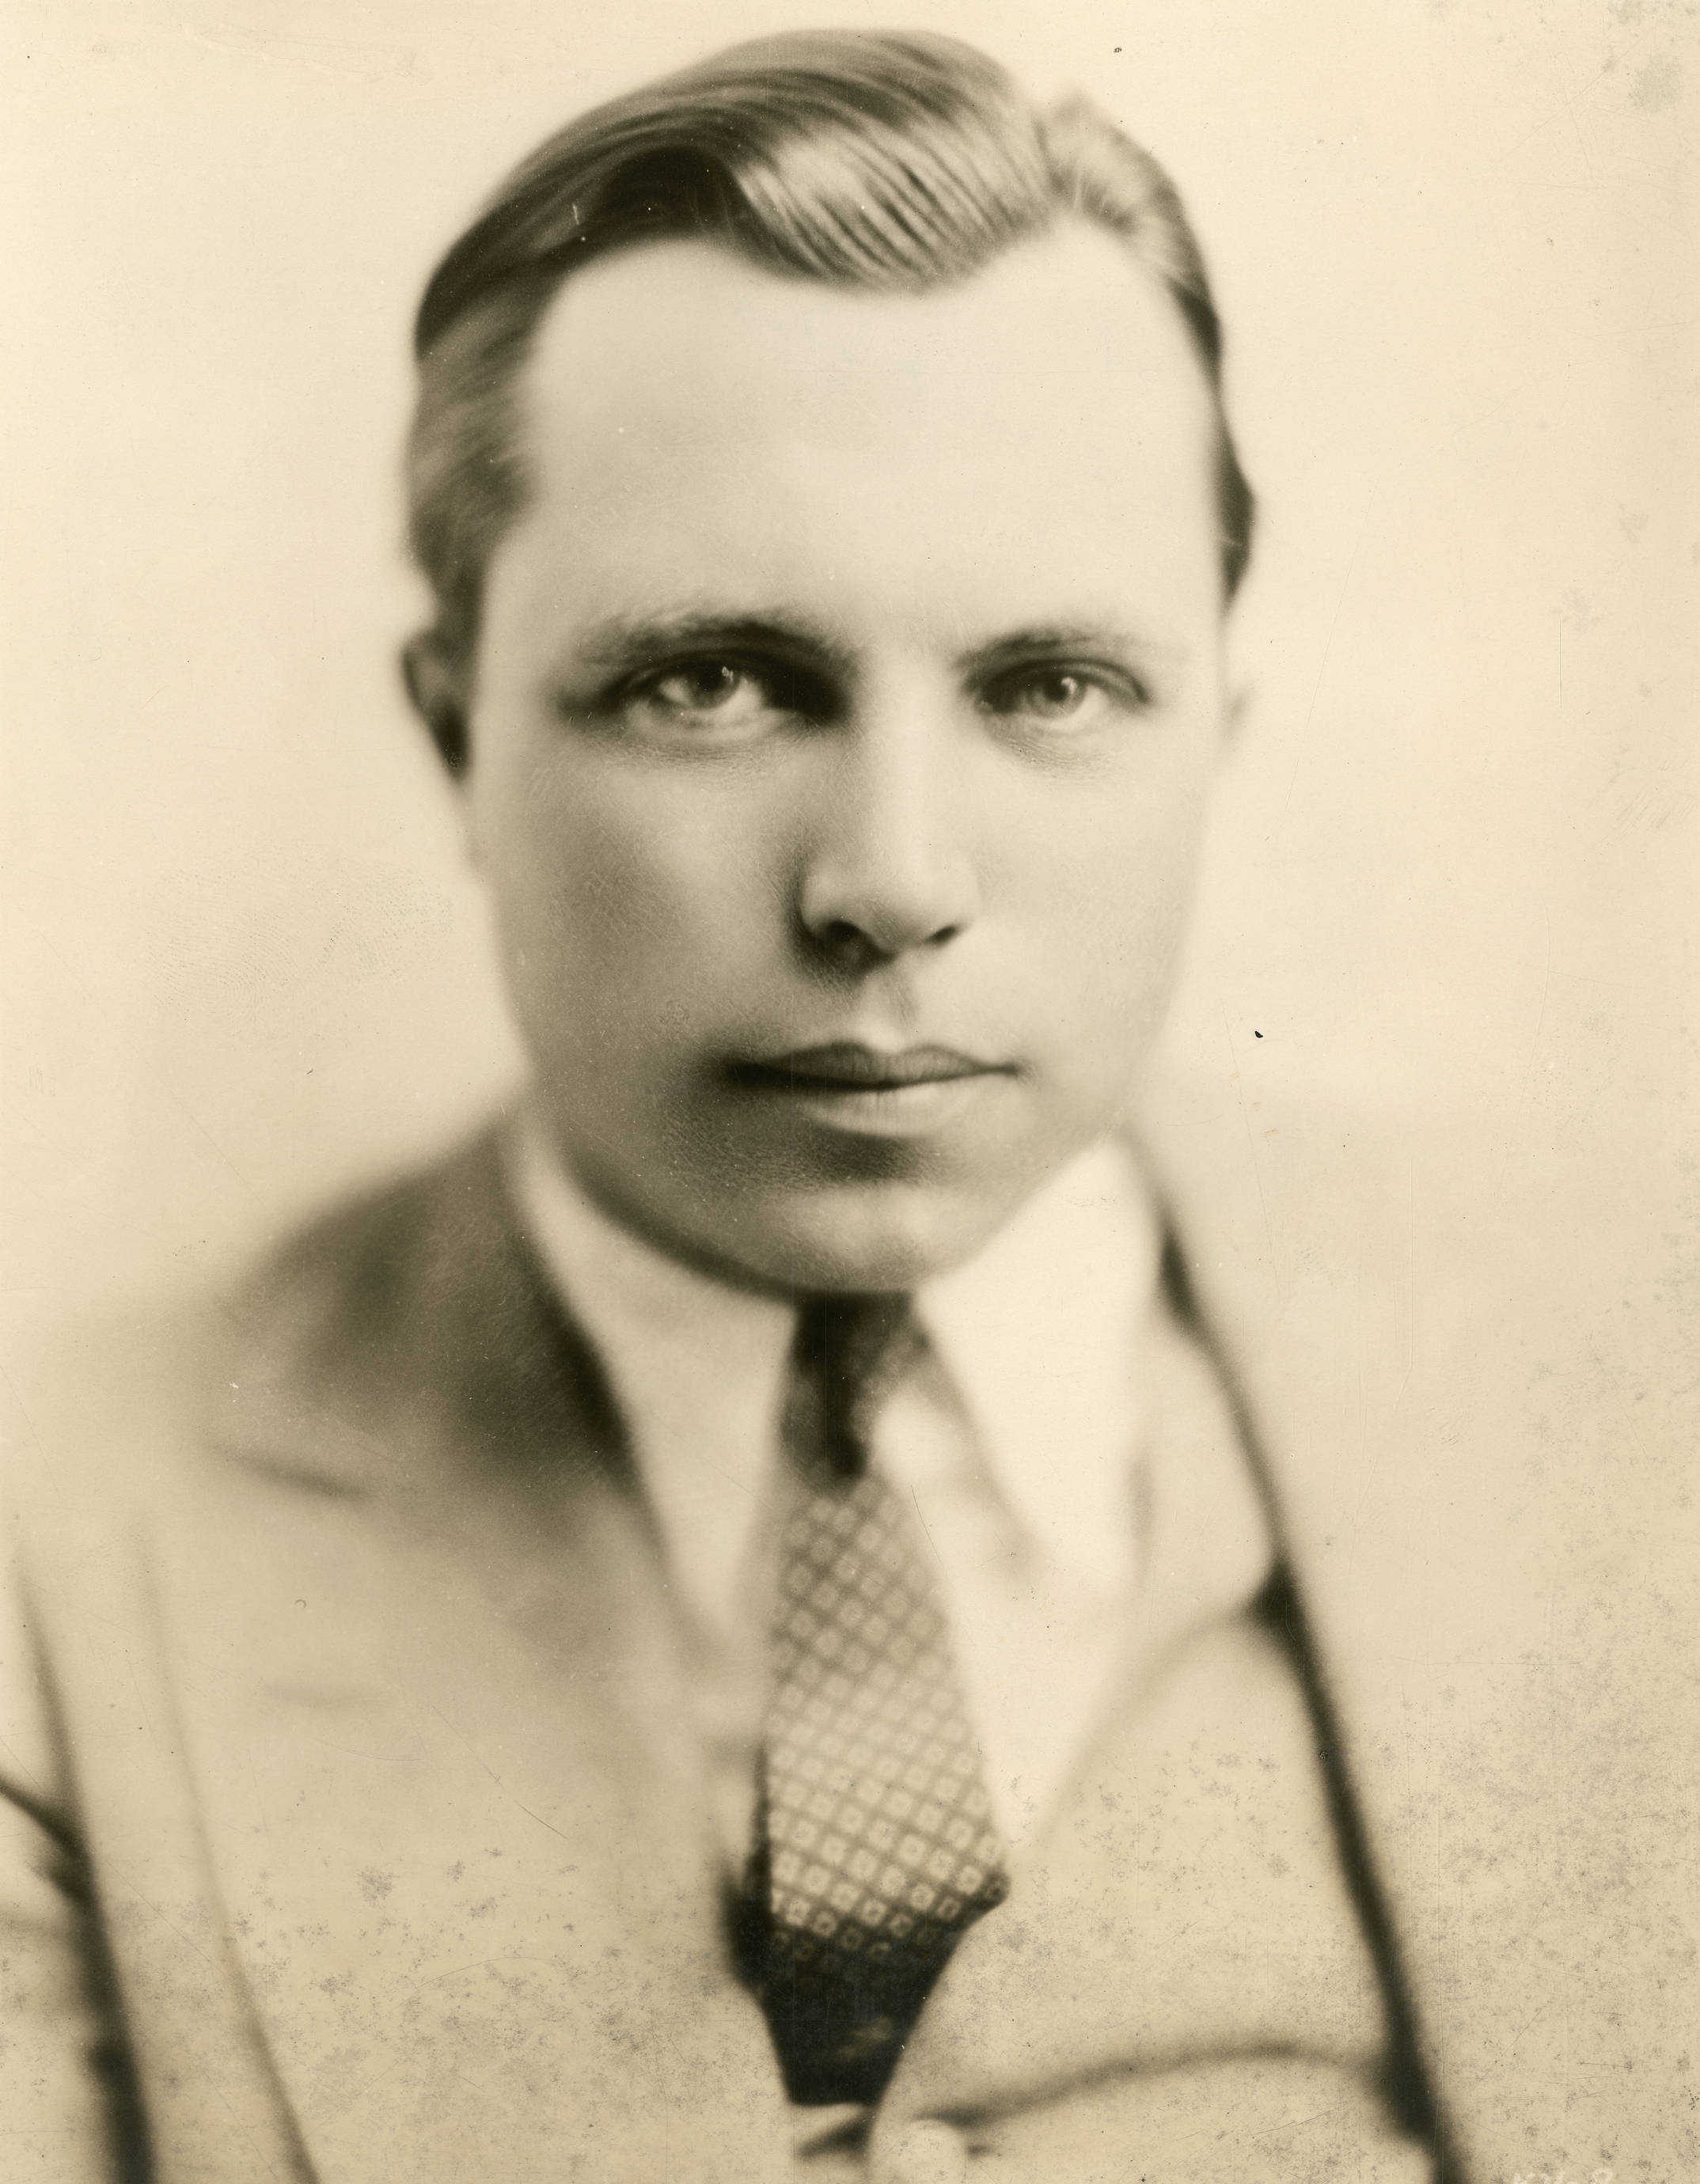
Murray’s story continued to affect Vidor throughout his life. Twenty years after his final feature film was released, the director attempted to get funding for a screenplay titled The Actor (A Story that Actually Happened), based on Murray’s life. It was never made.

Slide 8
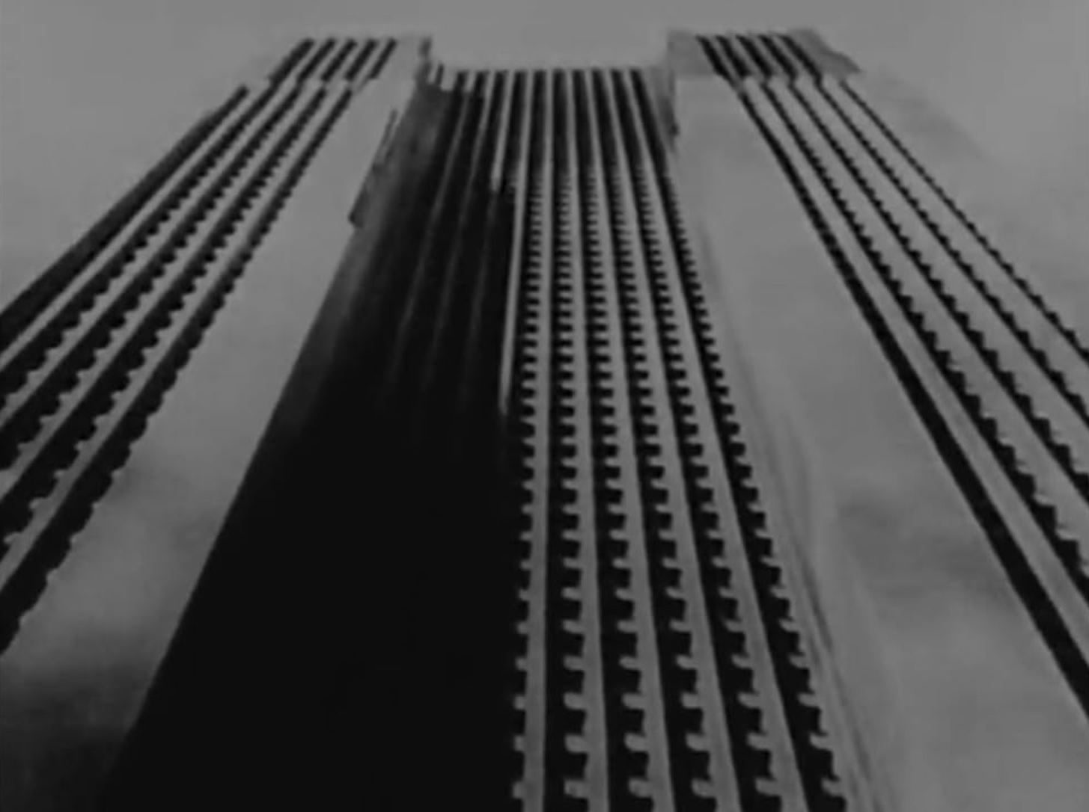
The iconic shot that scales John’s office building was created by using a model laid flat on the studio floor. The view inside the window is actually a still image from an earlier shoot placed behind the glass.

Slide 9
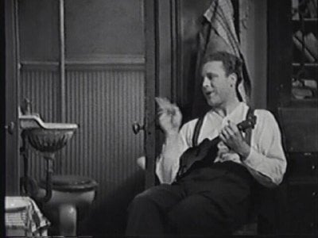
It is widely considered that Psycho featured the first toilet flushing in film, but decades earlier The Crowd caused controversy for featuring a toilet on screen.
MGM’s Louis B. Mayer voted against his own film in the Best Production Design Academy Award, calling it “that damned toilet picture”.

Slide 10
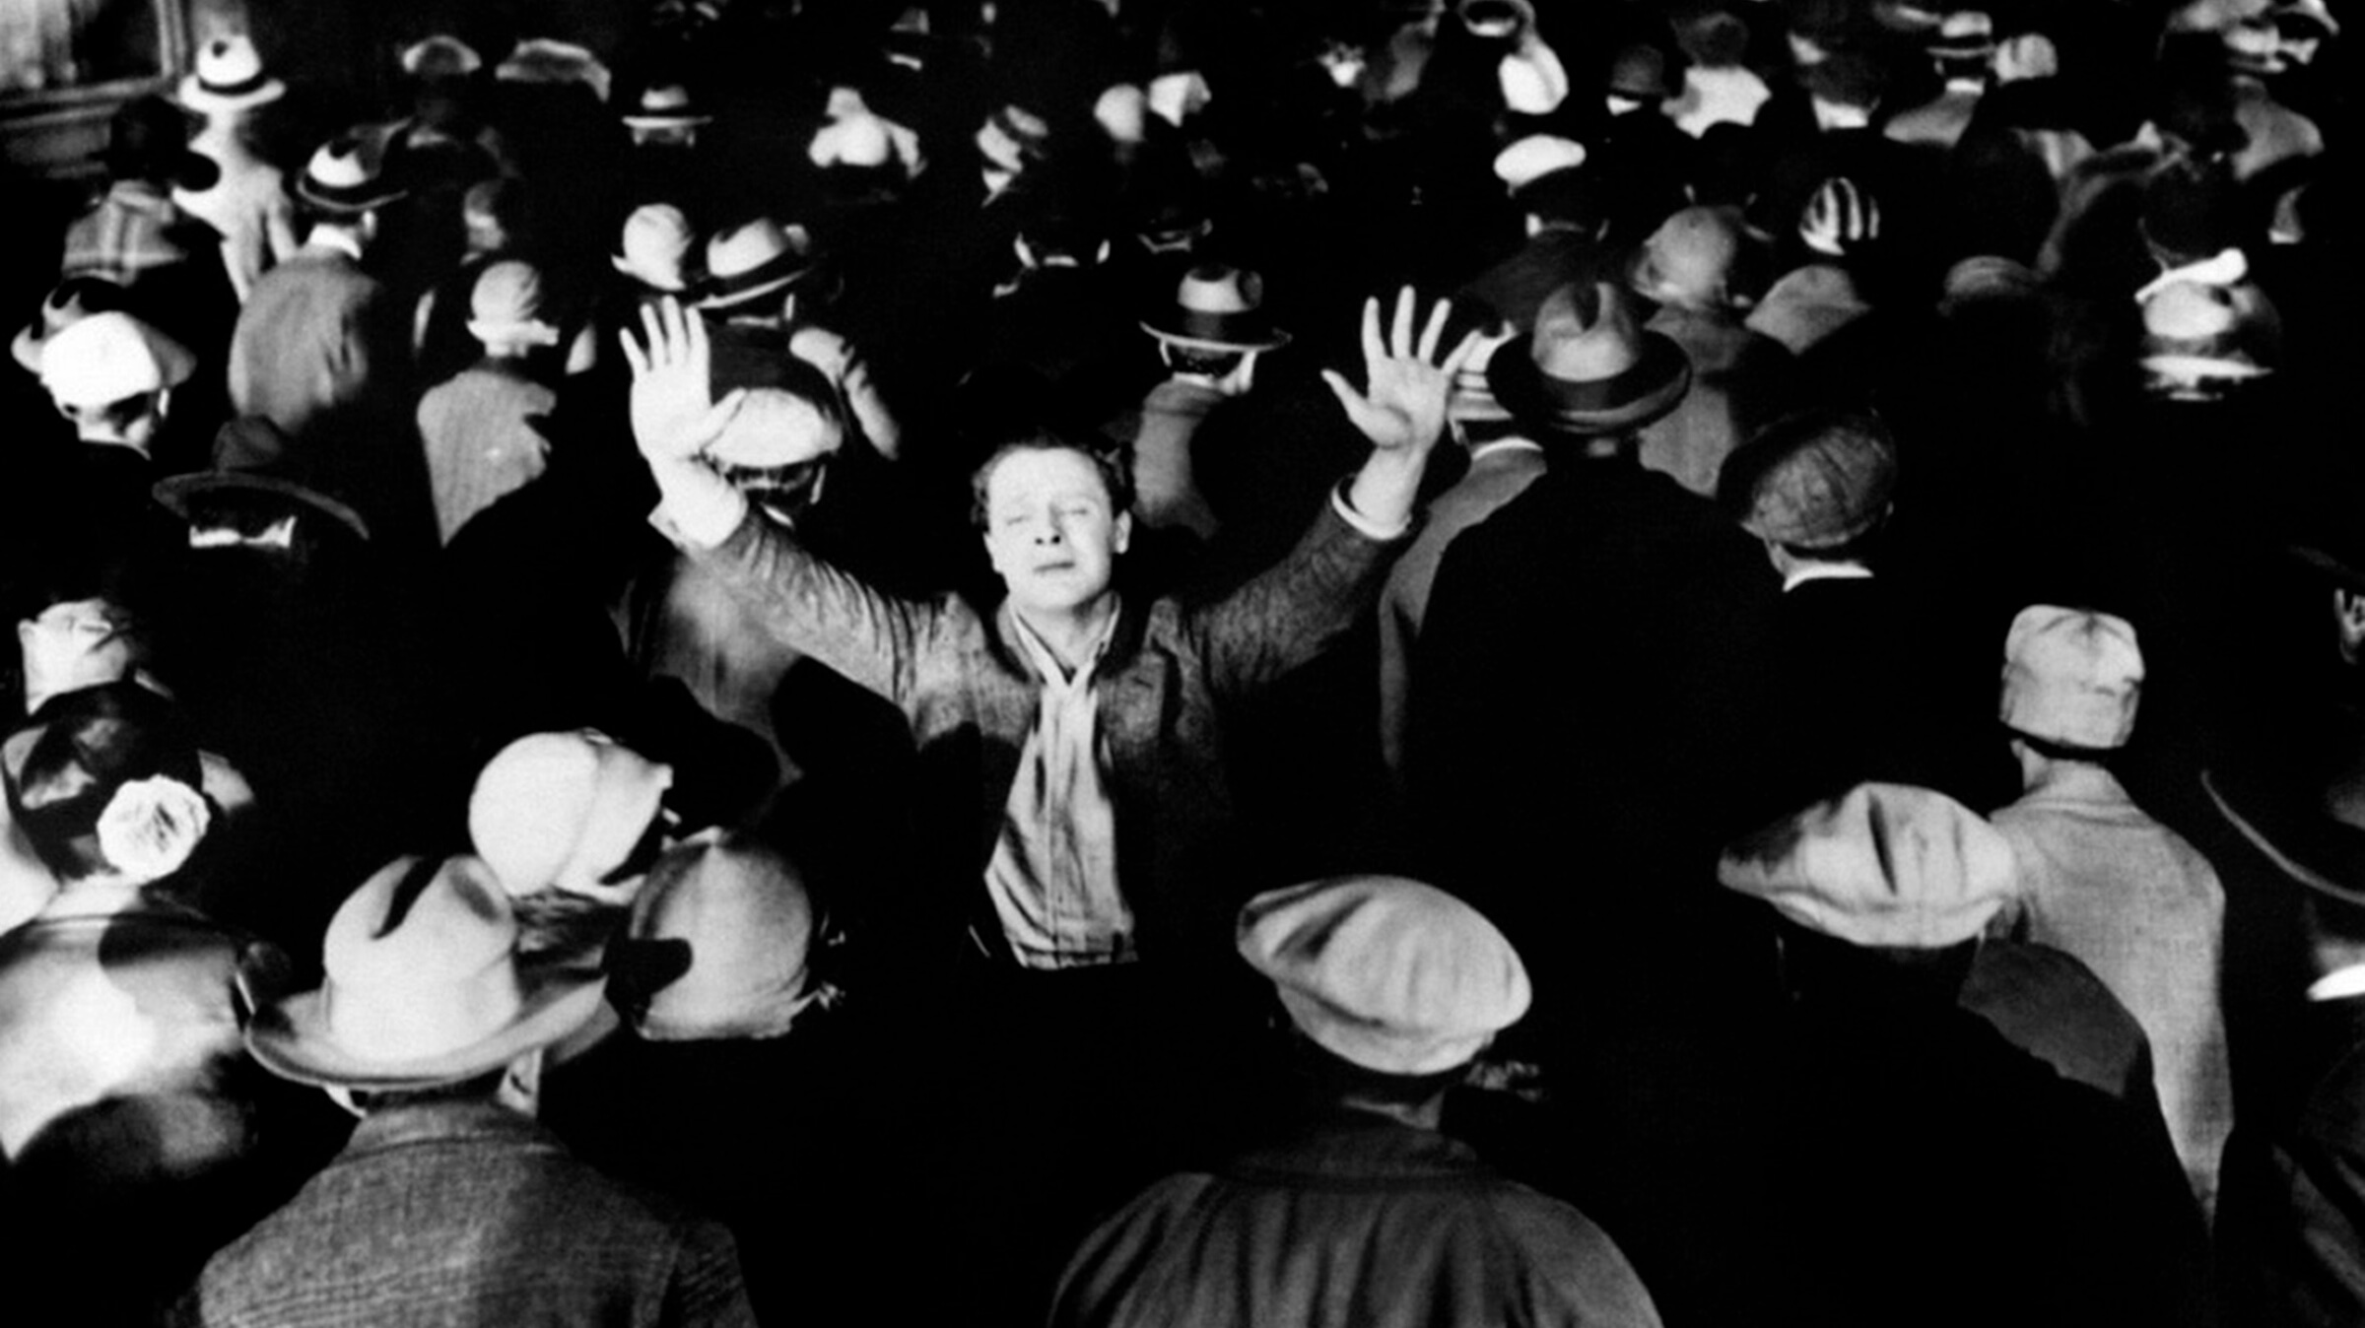
Due to concerns over the film’s denser themes, two endings were released to exhibitors – Vidor’s desired ending and a happier one.
According to Vidor, the happier ending was rarely chosen.

