Slide 1

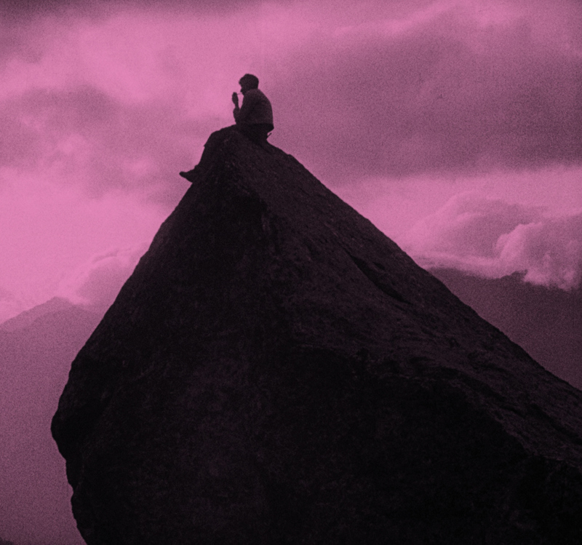
h
Mountain of Destiny
Arnold Fanck
1924
A daring tale of endurance, honour and adventure.

Slide 2
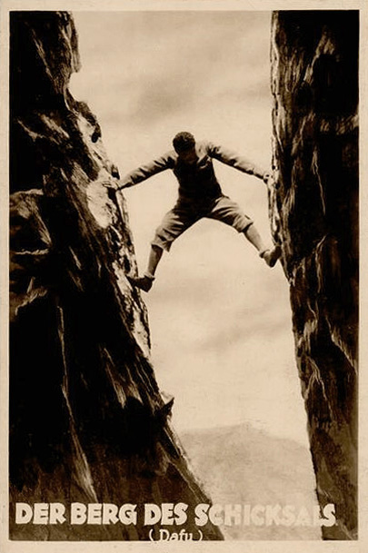
Mountain of Destiny (Der Berg des Schicksals) is a German film following a young man who, after vowing never to climb the mountain his father died summitting, must make a choice between honoring his promise and saving his childhood friend, Hella.
Notes:
Based on background and setting

Slide 3
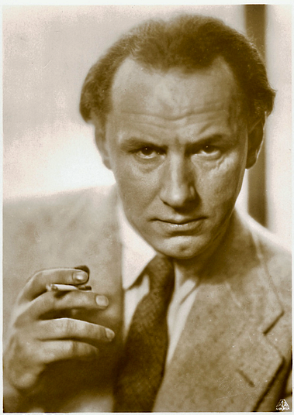
The film is directed by Arnold Fanck, a German filmmaker known for pioneering the Mountain Film genre.
His most internationally famous film, The Holy Mountain (1926), featured similar iconic alpine shots, but had a mixed critical reception.
Notes:
director

Slide 4
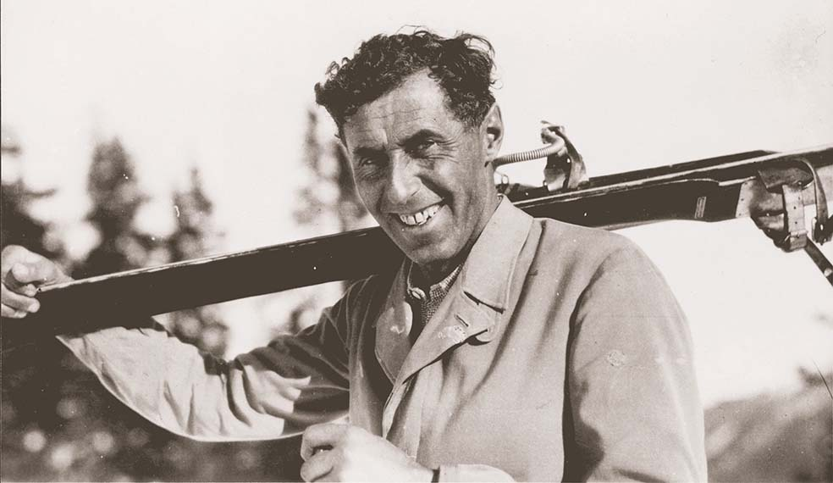
The father, Bergsteiger, is played by Austrian Ski instructor Hannes Schneider.
He is often considered the Father of Modern-Day Skiing.
During WW2 he helped to train the 10th Mountain Division of the U.S. Army, in which his son Herbert served.
Notes:
Also starring

Slide 5
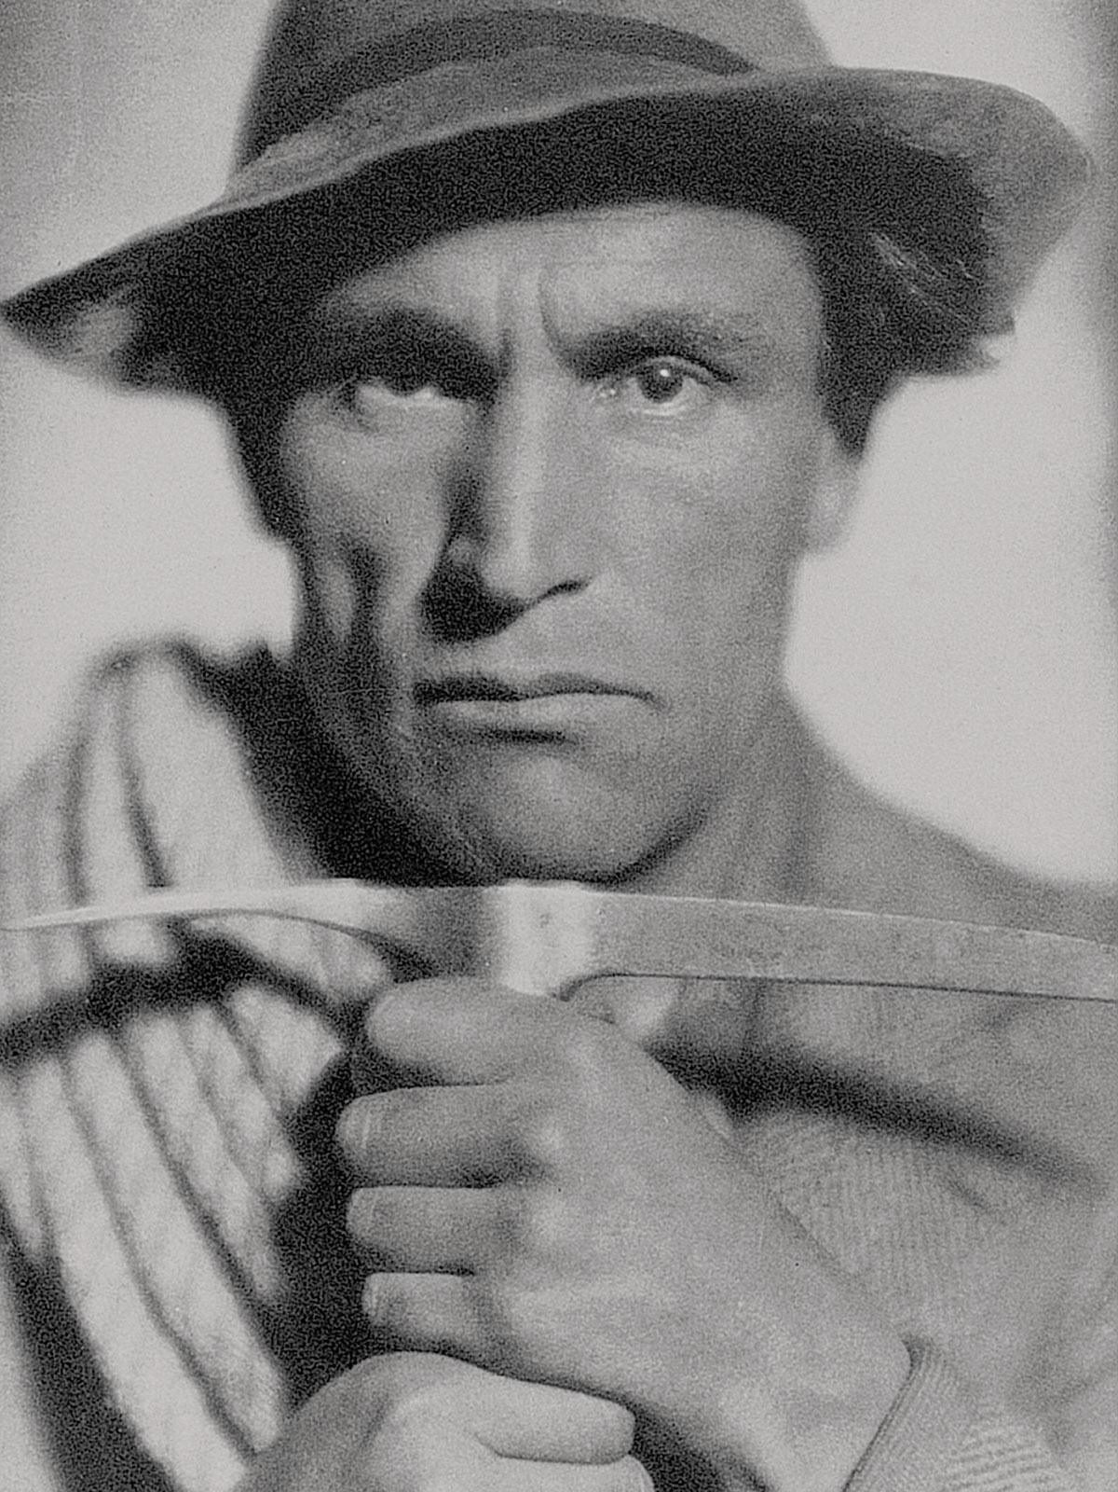
The ‘son’ is played by Italian actor, alpinist and bobsledder Luis Trenker.
It was his debut film, and he would work with Fanck again.
He went on to be a director and film producer, largely focusing on folklore and documentary-based work
Notes:
starring

Slide 6
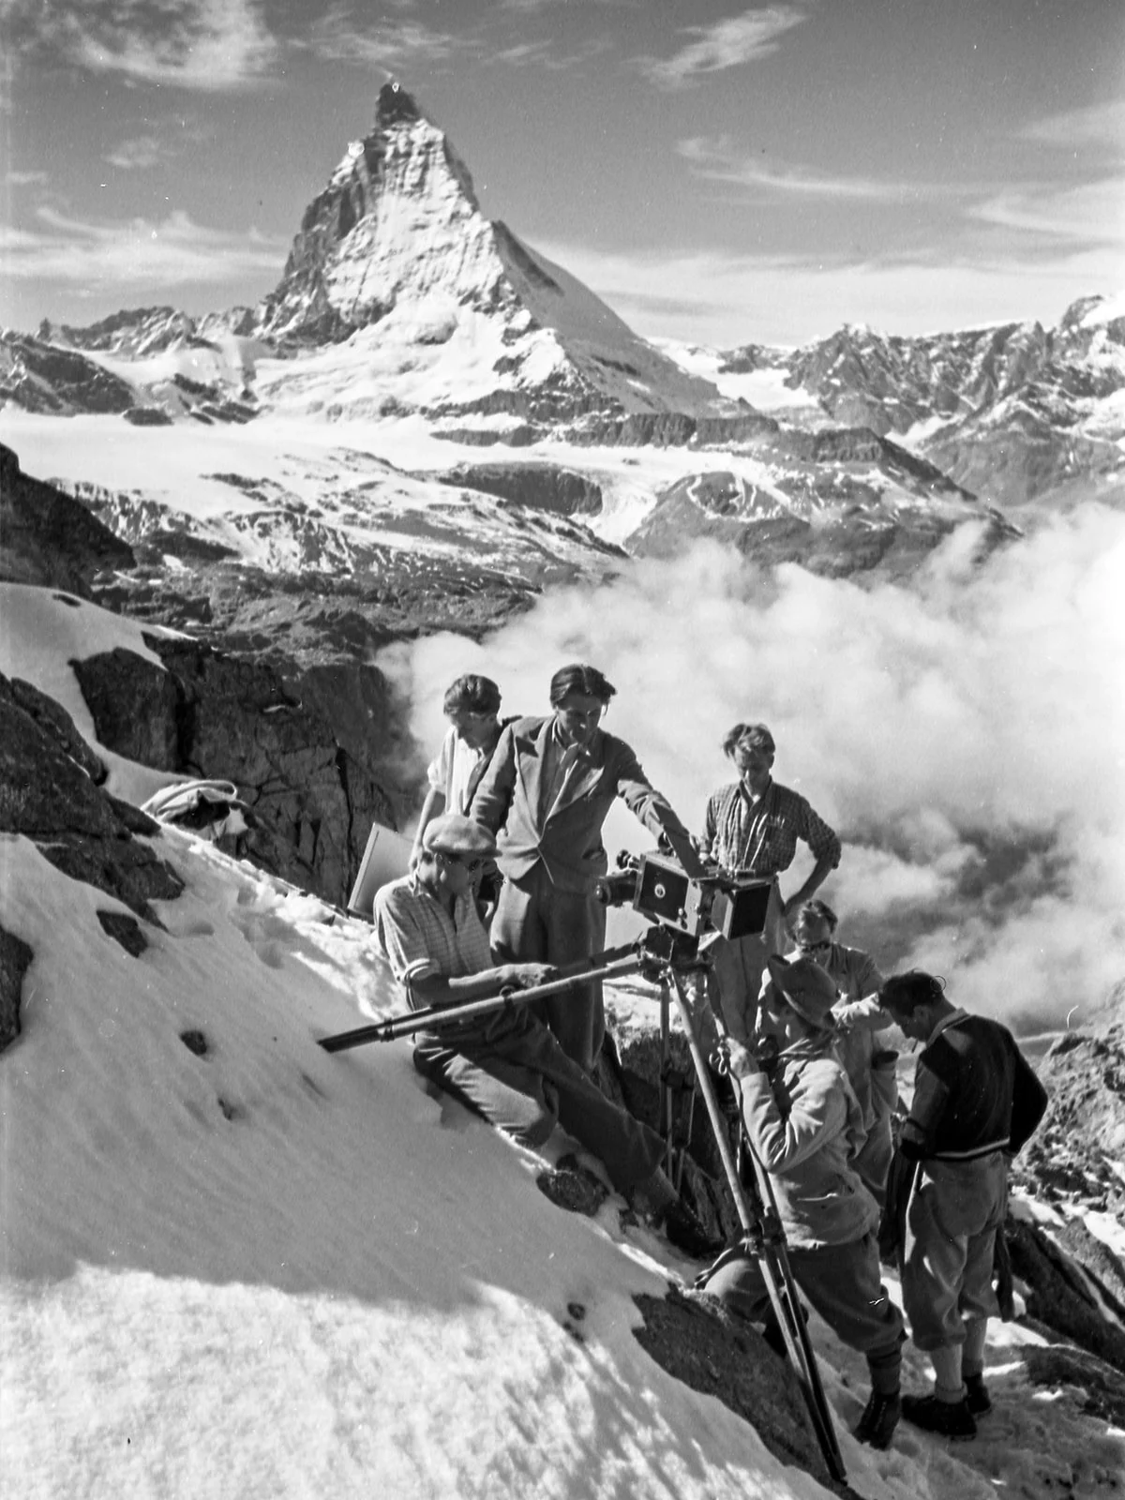
Both Fanck and many of the starring actors’ work was used by the Nazi Regime as propaganda.
After getting in trouble with the propaganda minister for making a film with a Frenchman and a Jew, Fanck “joined” the party.
After the war he would receive no further jobs and lived his life out as a Lumberjack.
Notes:
Behind the scenes of the film

Slide 7
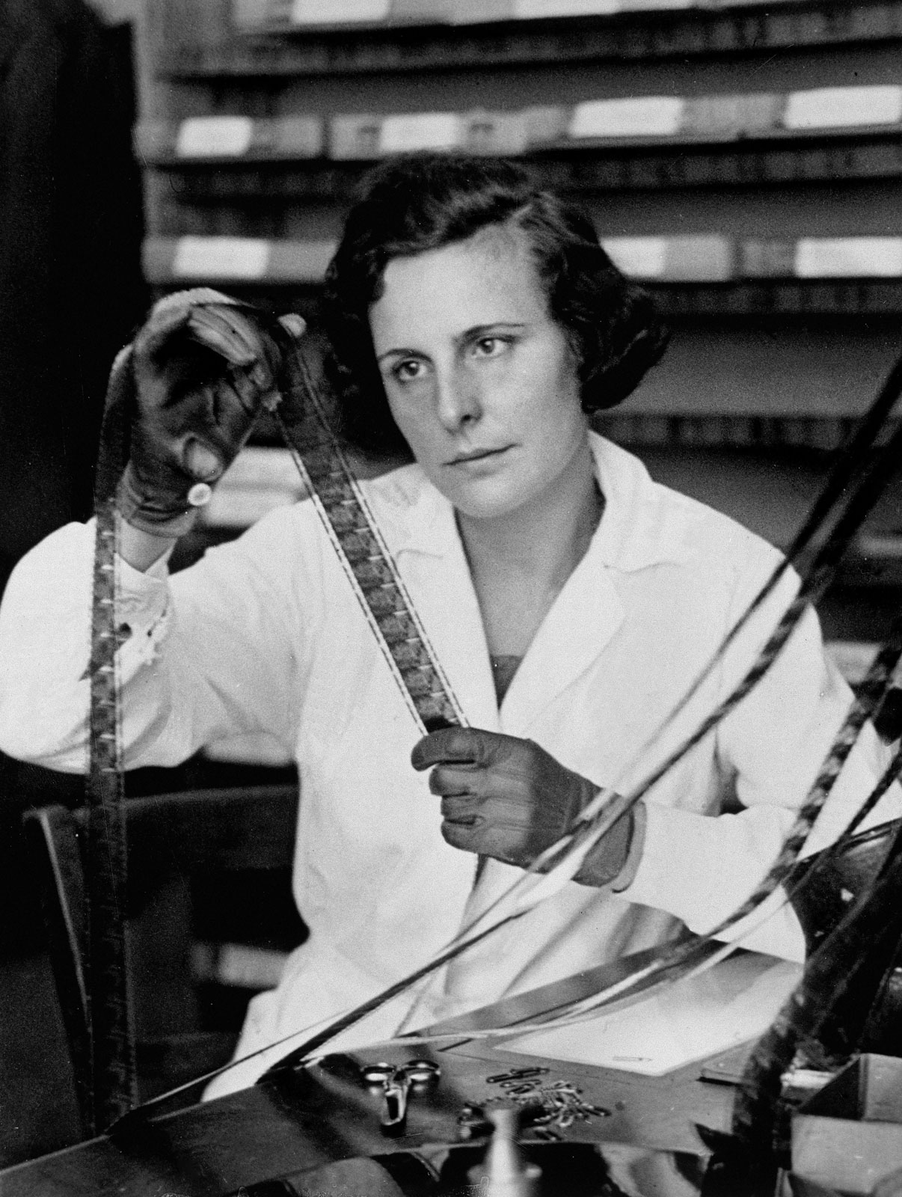
The film is said to have inspired Leni Riefenstahl, a controversial German filmmaker and dancer. She starred in Fanck’s next work, The Holy Mountain (1926)
She went on to be a Nazi-sympathiser, producing famous propaganda films for the National Socialist German Workers’ Party (Nazi Party) and having a personal connection to Hitler.
Notes:
What the film inspired – other fanck films

