Slide 1

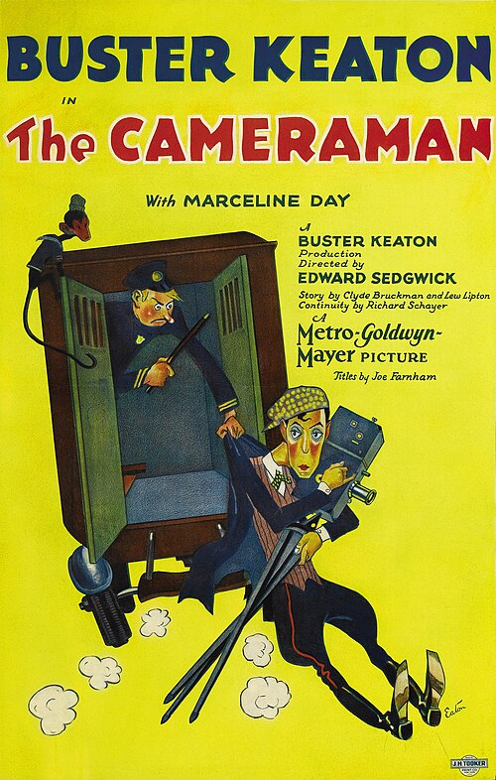
The Cameraman
Edward Sedgwick
1928
A hilarious slapstick comedy about a man, his camera, and a dream in the city that never sleeps.

Slide 2
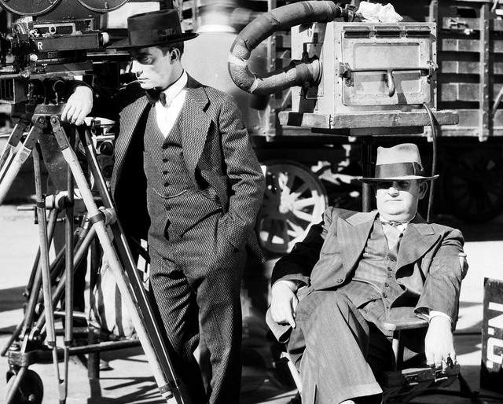
This film was Buster Keaton’s second-to-last silent movie before the industry moved to "talkies".
It is widely considered one of his greatest works, showcasing his incredible imagination as both an actor and a director (although he wasn’t officially credited as the director).
Much of it was filmed quickly on the real streets of New York, giving the picture a lively, spontaneous energy that studio productions simply couldn't replicate.

Slide 3
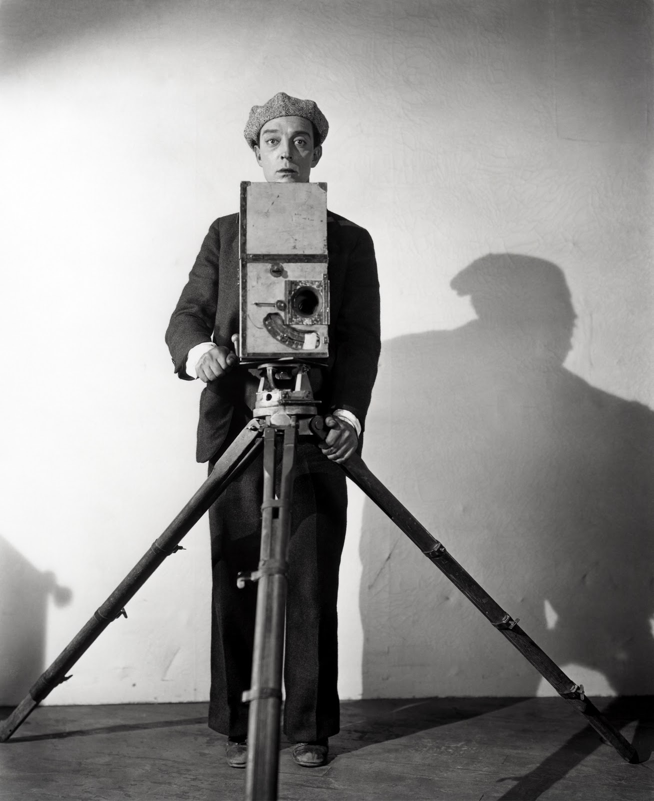
The film stars Buster Keaton as an "everyday man" who is determined to succeed and find love.
In the film, Buster’s character uses a classic, hand-cranked Pathé camera to try and make it as a news cameraman.
Buster Keaton was a legendary performer who grew up in "vaudeville" (theatre variety shows).
He was famous for his amazing physical comedy and for doing all his own dangerous stunts!

Slide 4
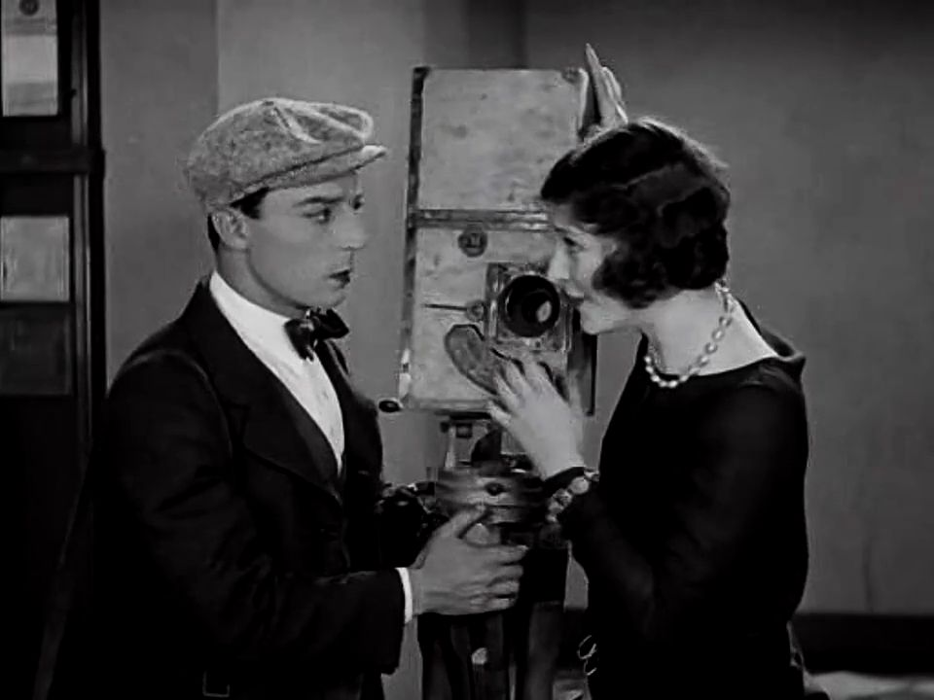
Marceline Day plays Sally, Buster’s love interest, and brings real spark to the role.
A former child actress who worked with some of Hollywood's biggest names, including Lon Chaney, Day had already built a formidable career by the time she appeared here.

Slide 5
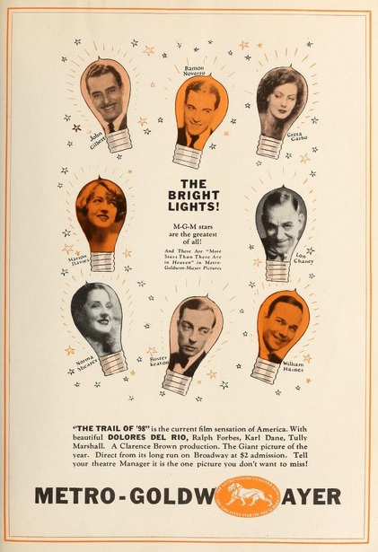
In 1928, Keaton signed with MGM, one of Hollywood's most powerful studios. The Cameraman was his debut under that contract, and commercially it was a success.
Keaton, however, came to regard the move as one of the great mistakes of his career. After years of running his own independent studio with full creative control, he found the rigid structure of a major studio deeply stifling.

Slide 6
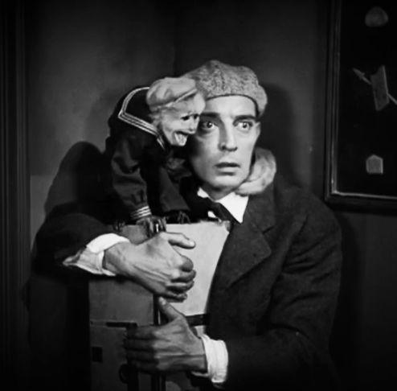
Keaton was no stranger to animal co-stars. Across his films he shared the screen with a cow, a bulldog, and a horse, among others.
In The Cameraman, his scene-stealing companion is Josephine the Monkey, a seasoned performer who also appeared alongside Charlie Chaplin!

Slide 7
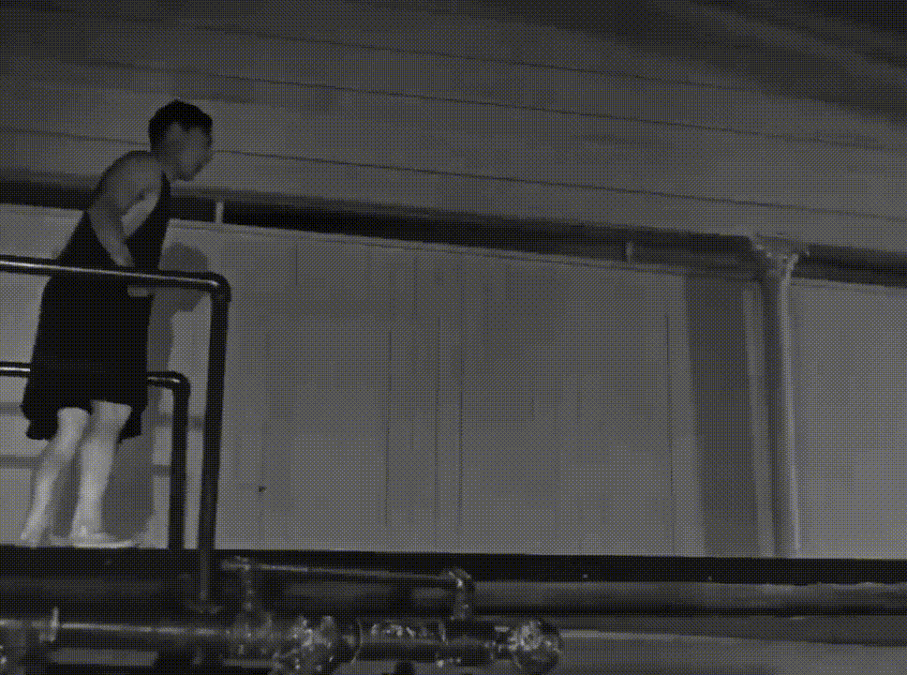
The film features some of the most well-known comedy scenes in history, including a crowded changing room and a hilarious mishap at a public swimming pool.
These scenes show off Keaton’s amazing timing and his ability to find humour in everyday, relatable situations.

Slide 8
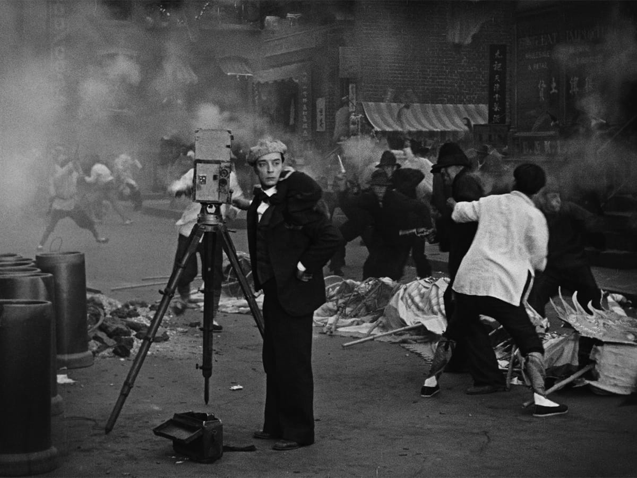
The Cameraman is a perfect example of a "film-within-a-film."
It gives the audience a fun, behind-the-scenes look at how movies were made in the 1920s.
By showing the character’s funny struggles to get the "perfect shot," Keaton makes lighthearted fun of the movie industry and how much it loves big, dramatic spectacles.

