Slide 1

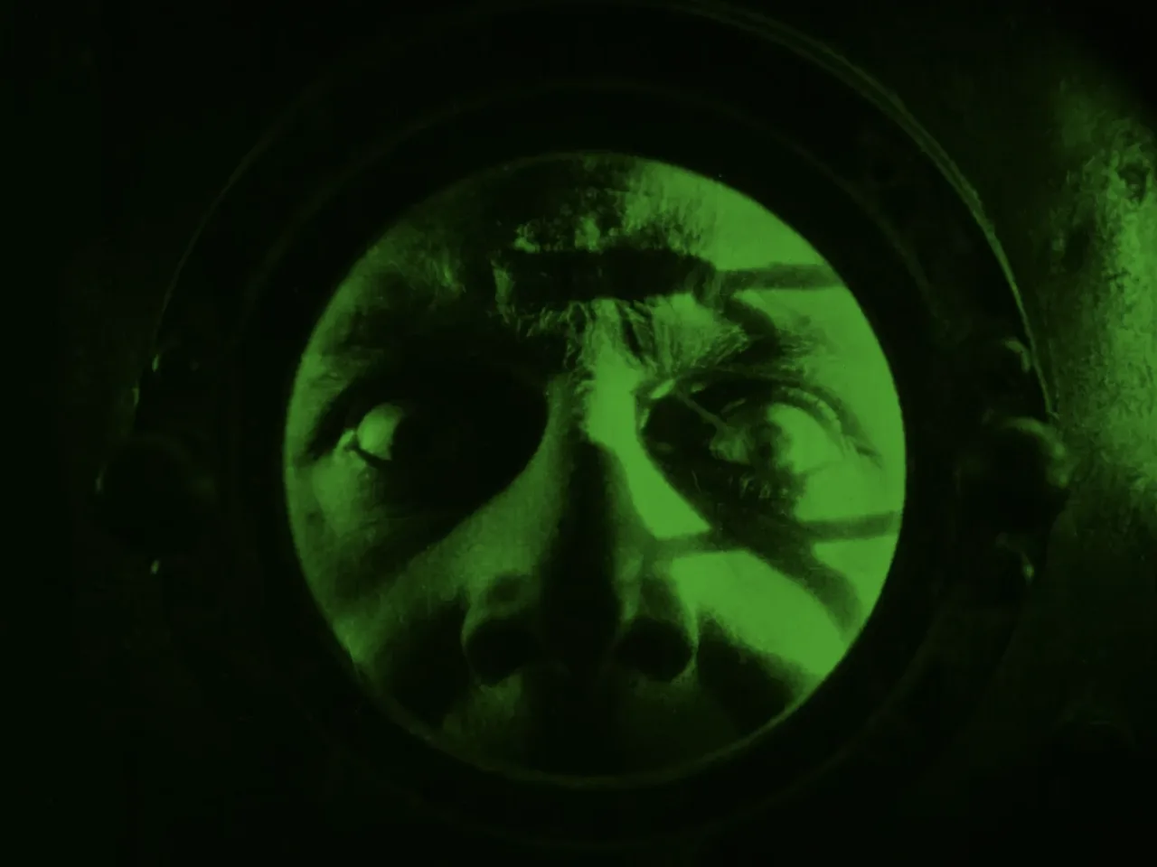
The White Heather
Maurice Tourneur
(1919)

Slide 2
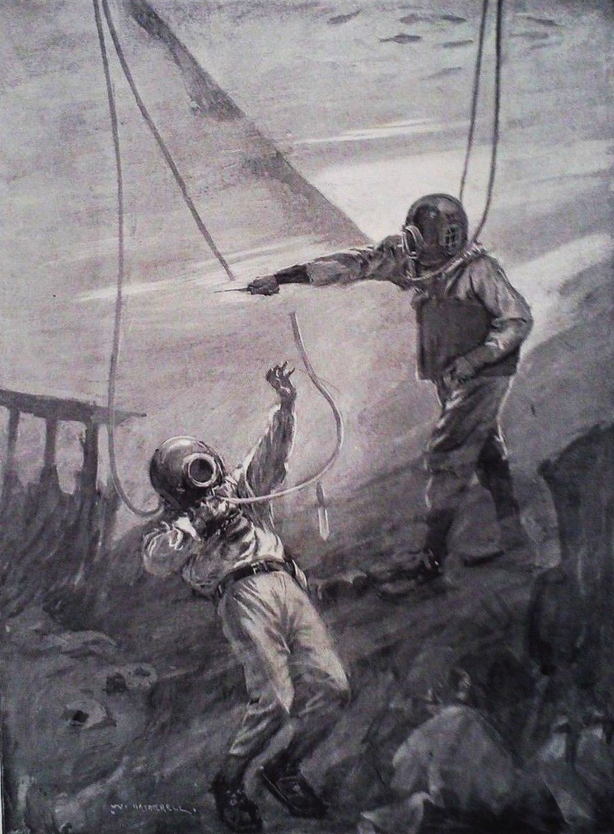
The White Heather originated from a popular 1897 melodrama of the same name performed at the Theatre Royal Drury Lane. The play was famous for its spectacular stage effects.
Producers used a hydraulic lift to simulate a boat rising in a loch and staged an ‘underwater’ battle featuring live fish from an aquarium projected via a magic lantern.

Slide 3
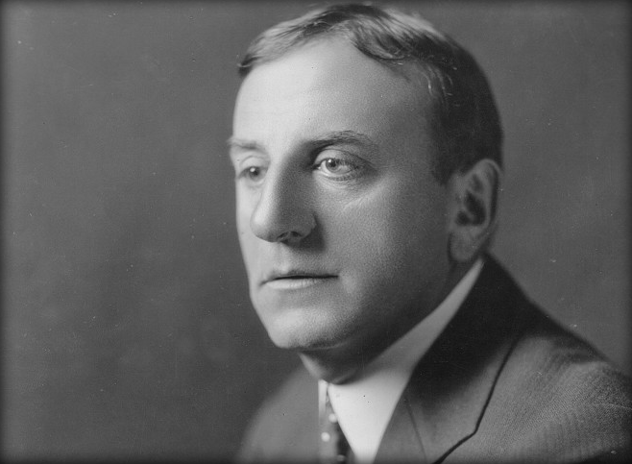
Born in 1873, French director Maurice Tourneur originally trained as a painter and sculptor, assisting Auguste Rodin.
Tourneur also spent a decade in the theatre directing Grand Guignol plays – an extreme theatre form famed for its amorality, bleak storylines and gory effects.
In 1912, at the age of forty, Tourneur made his transition into cinema.

Slide 4
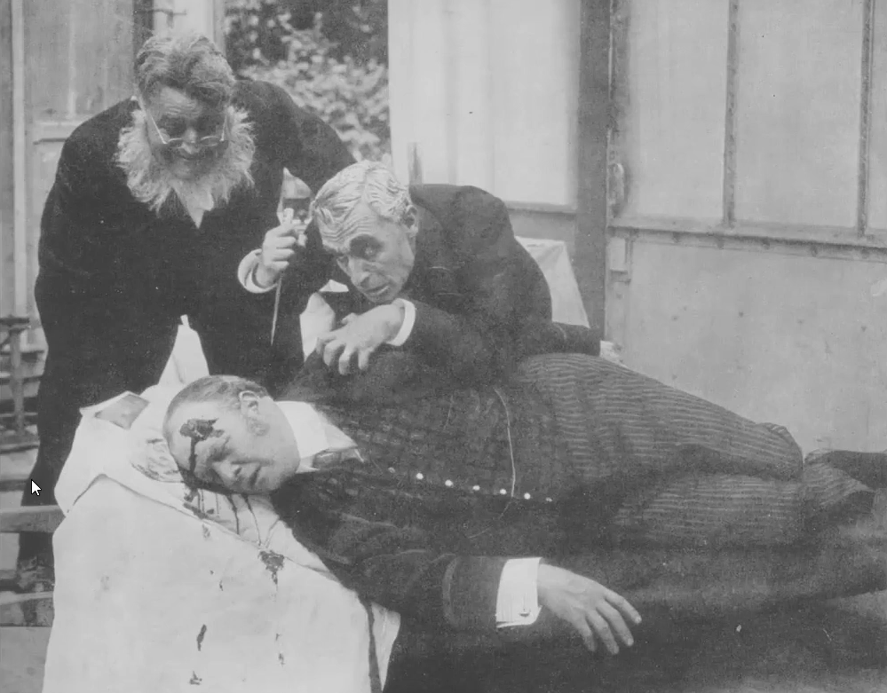
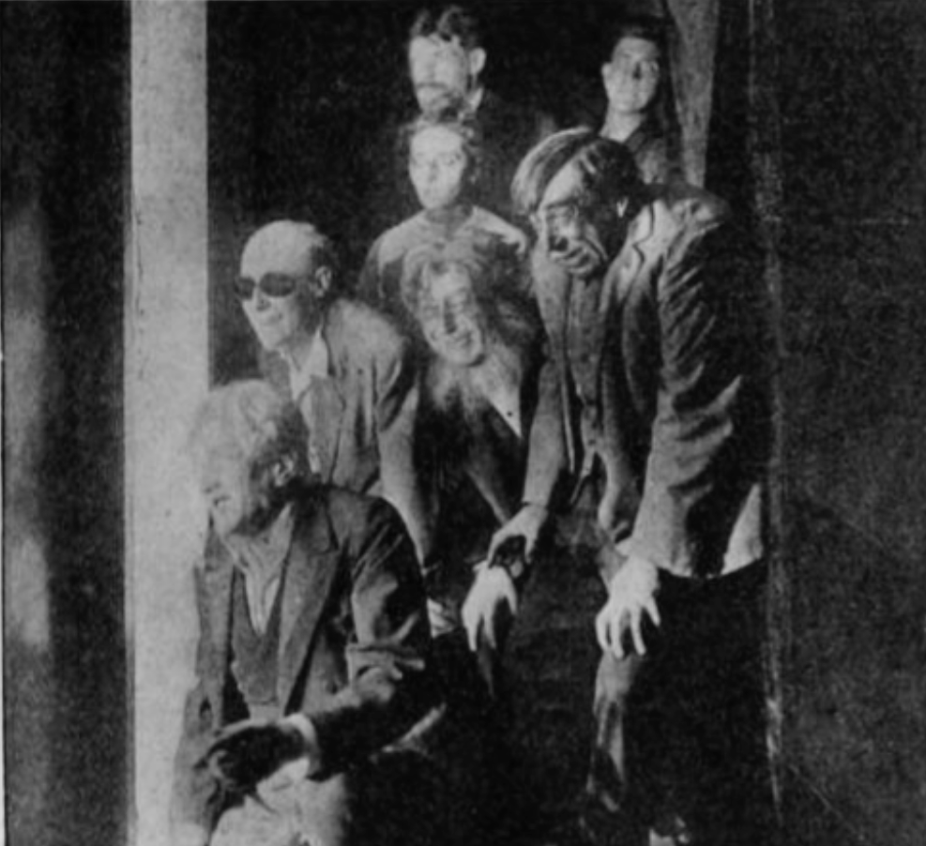
Tourneur believed cinema had a “a brutality that no other form of expression possesses.”
His lost film Le Système du docteur Goudron et du professeur Plume (1913), adapted from an Edgar Allan Poe story, is considered the first French horror film.
His son, Jacques Tourneur, would decades later become famous for his own horror films, including Cat People (1942) and I Walked with a Zombie (1943).
Le Système du docteur Goudron et du professeur Plume (1913)

Slide 5
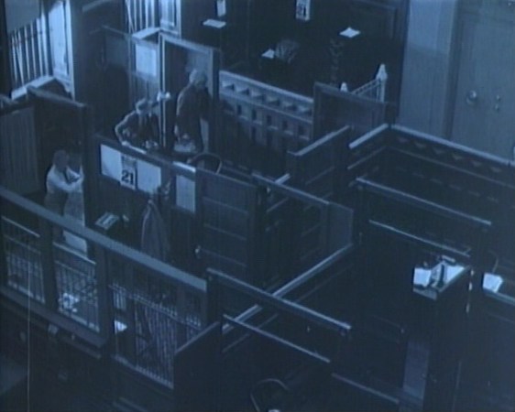
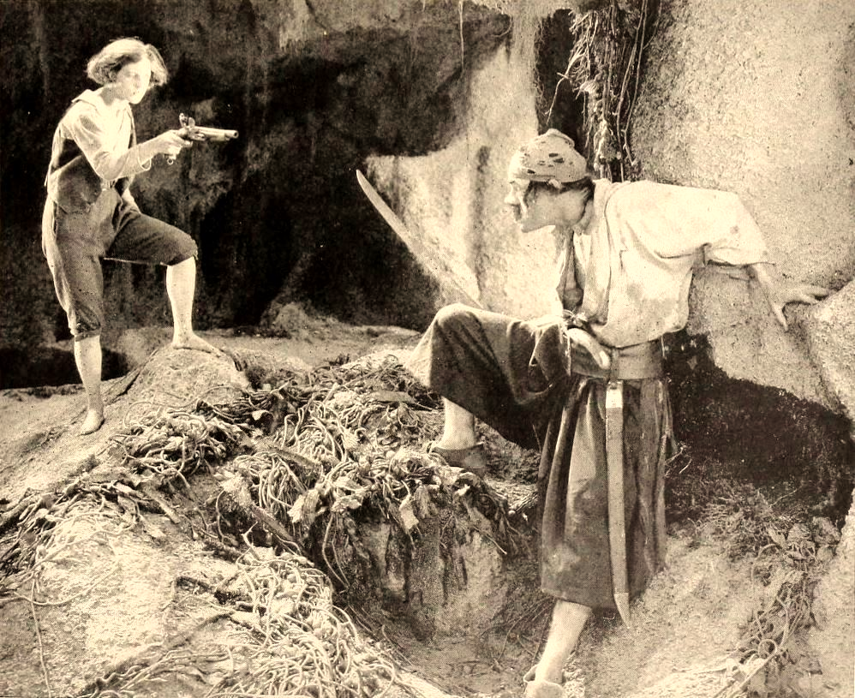
Alias Jimmy Valentine (1915)
Treasure Island (1920)
Alongside the first French horror film, Tourneur has some other impressive firsts. Most notable are Alias Jimmy Valentine (1915), considered the first feature-length gangster film, and Treasure Island (1920) – a Lon Chaney picture regarded as the first pirate film.

Slide 6
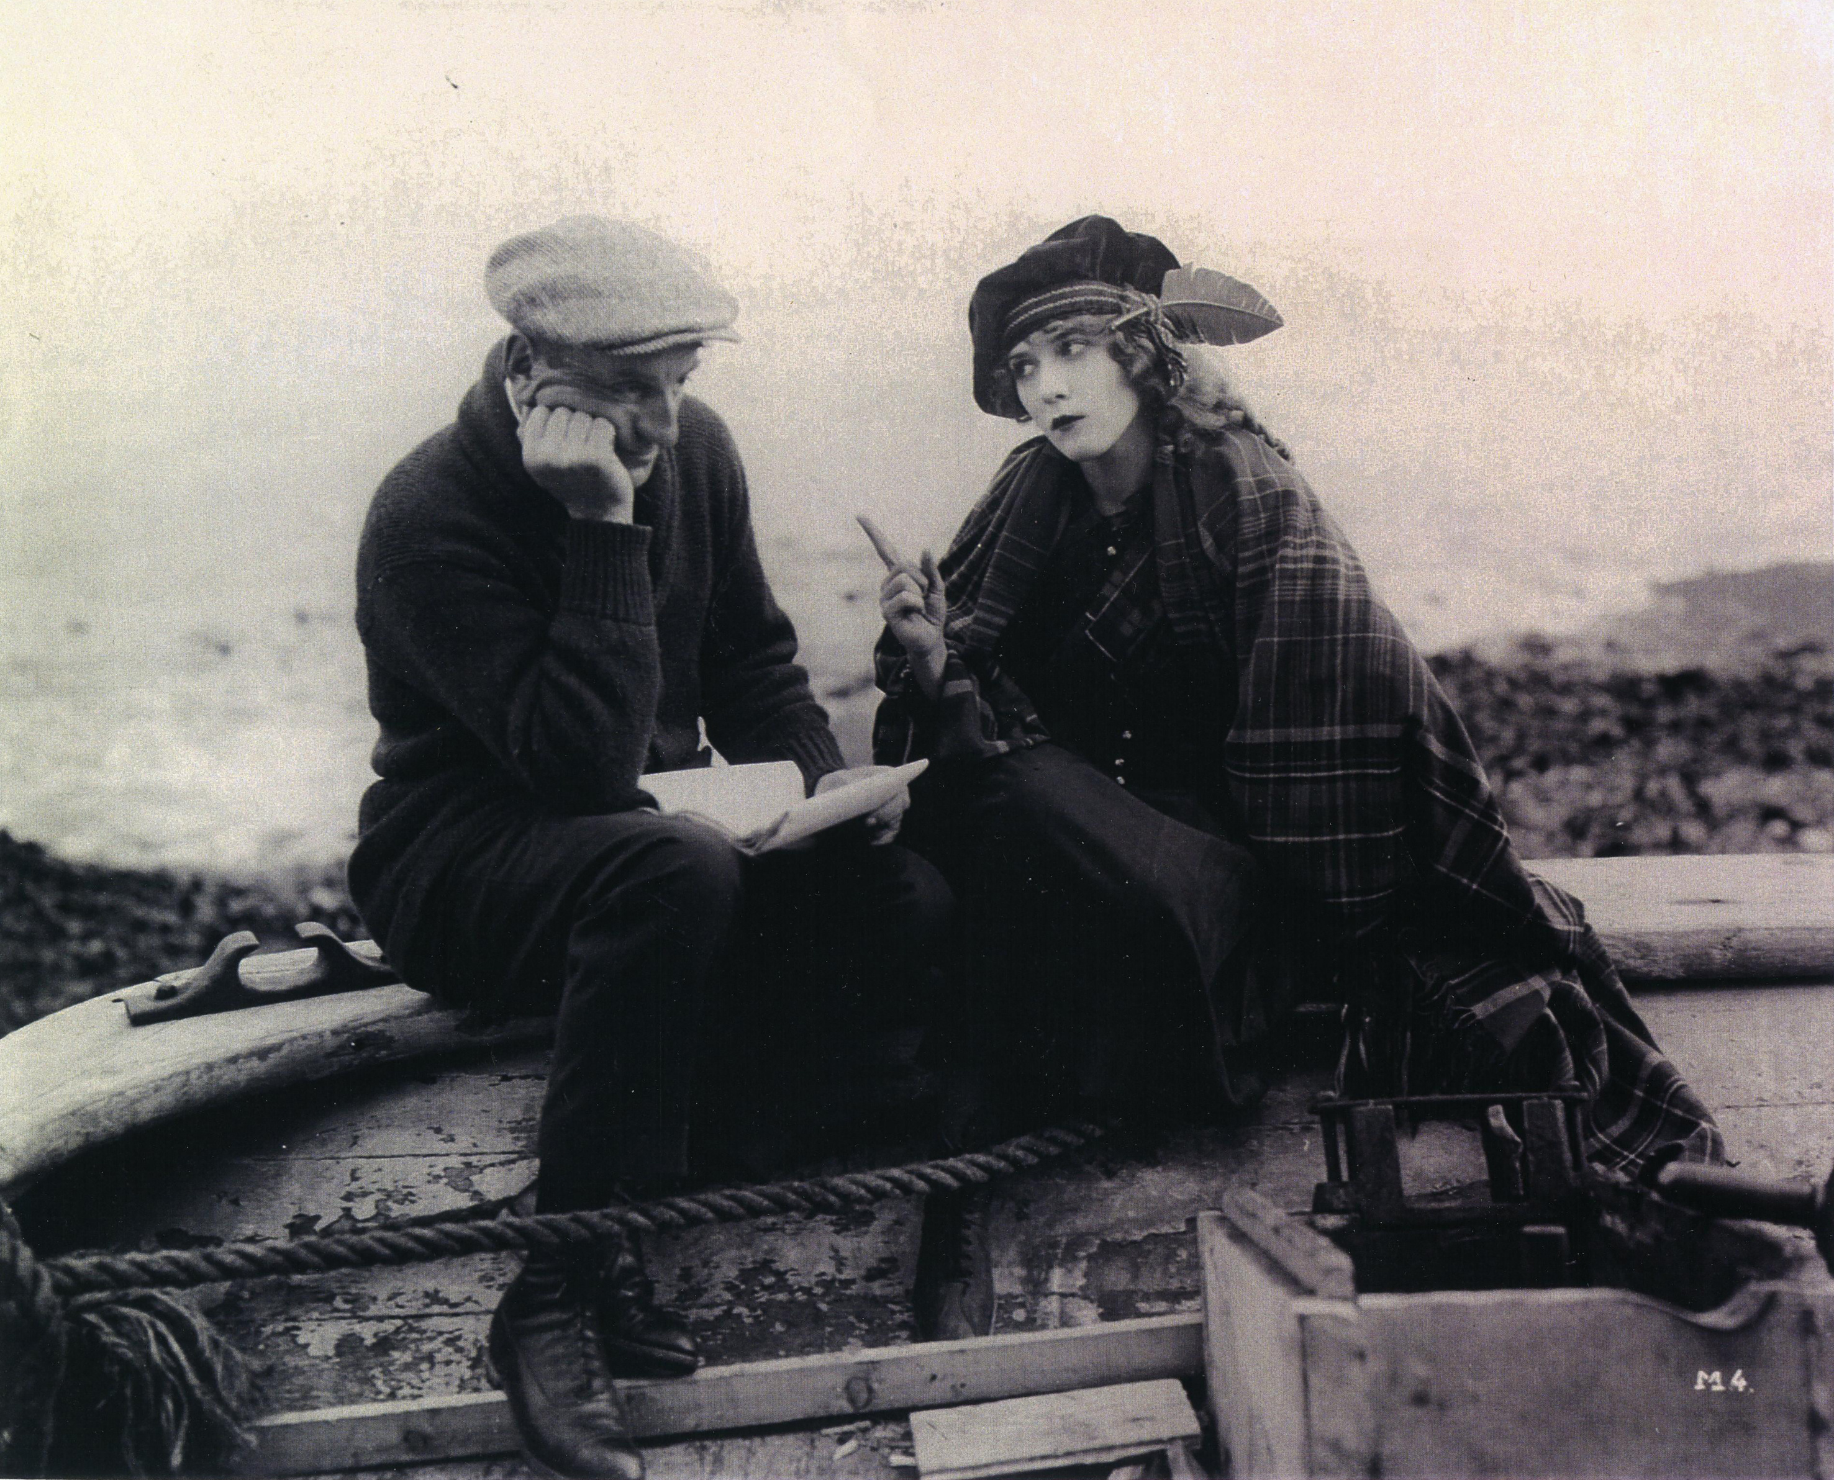
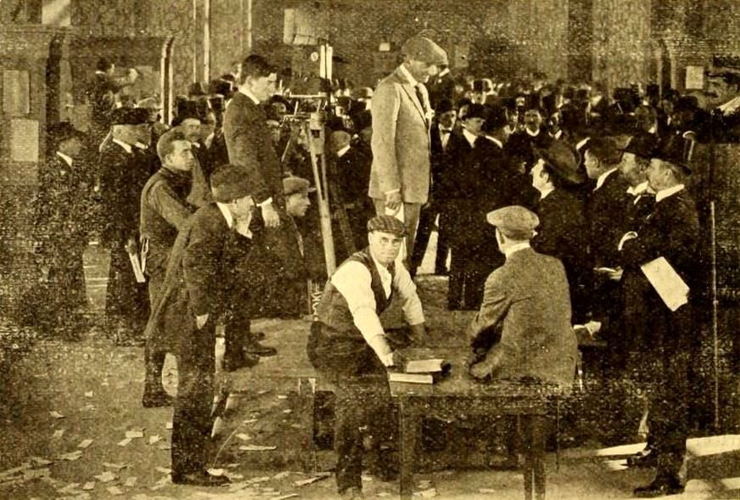
The star Mary Pickford chose Tourneur to direct The Pride of the Clan (1917). Consequently, Tourneur was able to establish his own studio the following year.
After a string of commercially unsuccessful films, Tourneur wanted to make pictures that attracted larger audiences. Hence, he selected a popular Drury Lane melodrama – The White Heather.
Tourneur and Pickford on the set of The Pride of the Clan (1917)
Tourneur on the set of The White Heather (1919)

Slide 7
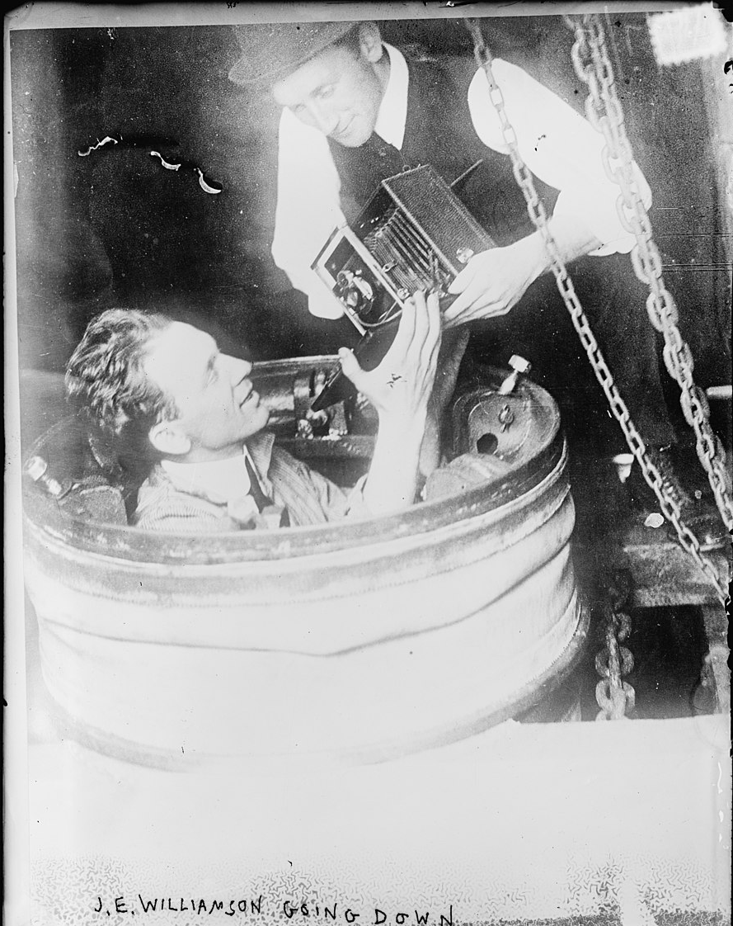
The story’s sensational elements appealed to Tourneur, who with the aid of the Williamson Submarine Tube and Patented Inventions, managed to film a groundbreaking underwater action scene.
For more on the history of underwater photography, read Kathy Rose O’Regan’s programme notes available online at www.hippodromecinema.co.uk.

Slide 8
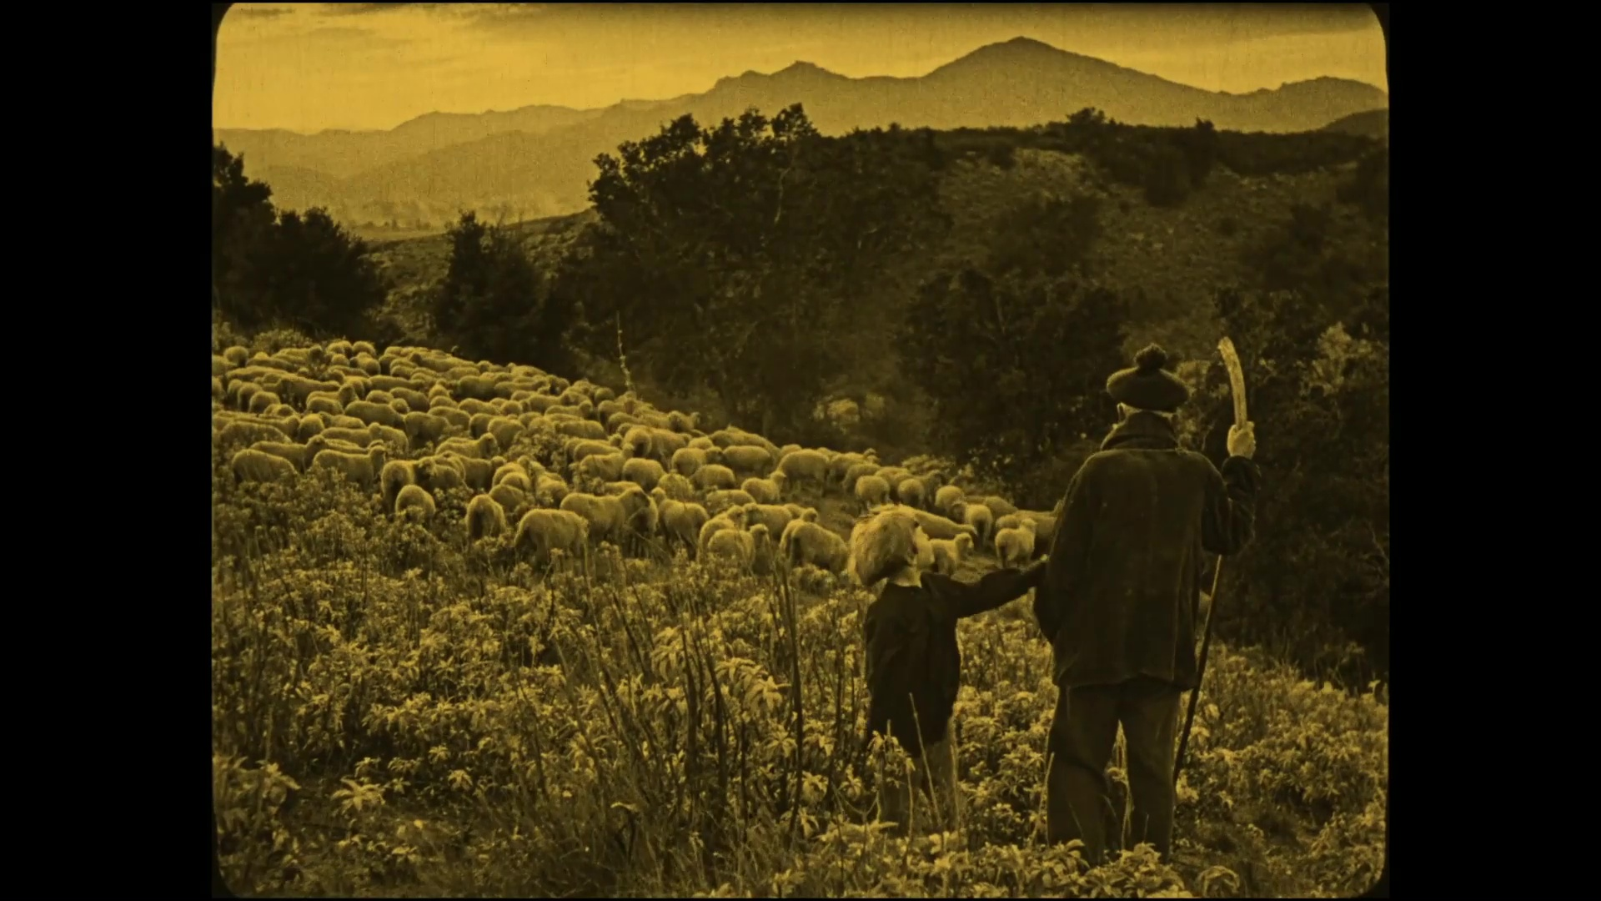
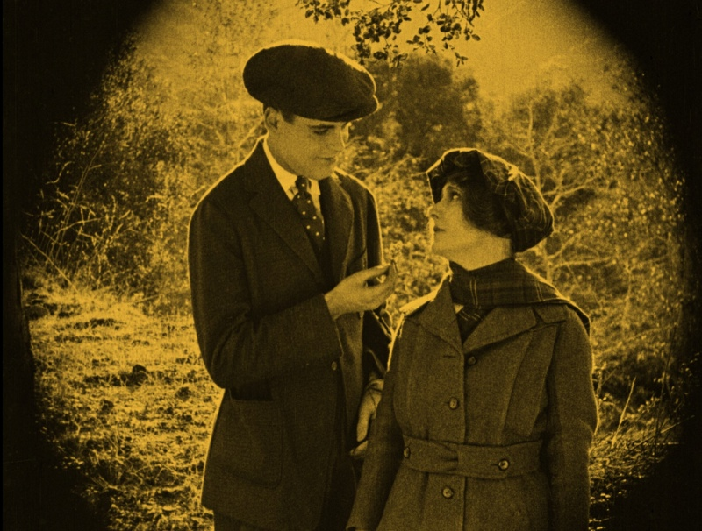
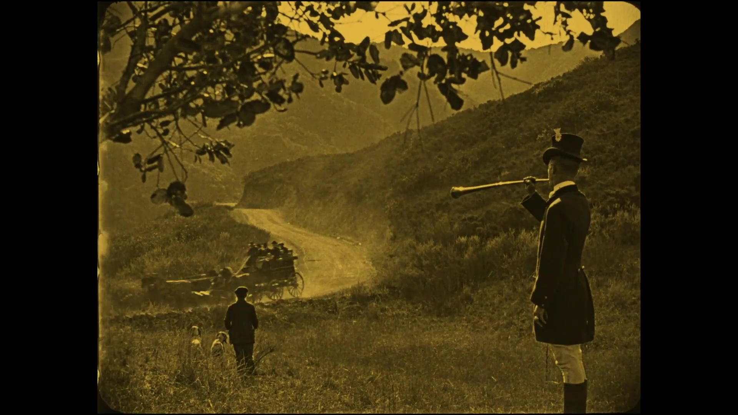
The film is partly set in the fictional Shetland castle, ‘nestled amongst the heather-covered hills of Scotland, where the ancient customs of that region are still scrupulously observed’.
Whereas Massachusetts had stood in for the Scottish Hebrides in The Pride of the Clan, The White Heather was filmed in California as Tourneur argued that geographical fidelity was “valueless from the standpoint of art”.

Slide 9
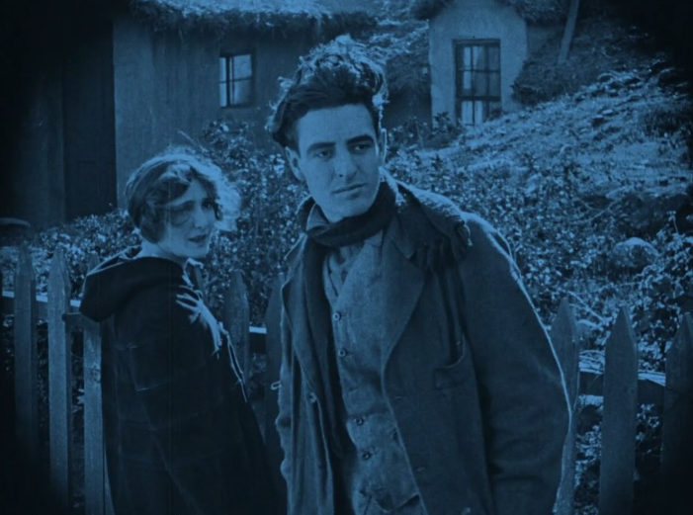
The White Heather stars Mabel Ballin, Ralph Graves, and a young John Gilbert (credited as Jack Gilbert).
John Gilbert was a member of Tourneur’s crew, working as a screenwriter on The White Heather alongside the small role of Dick Beach.

Slide 10
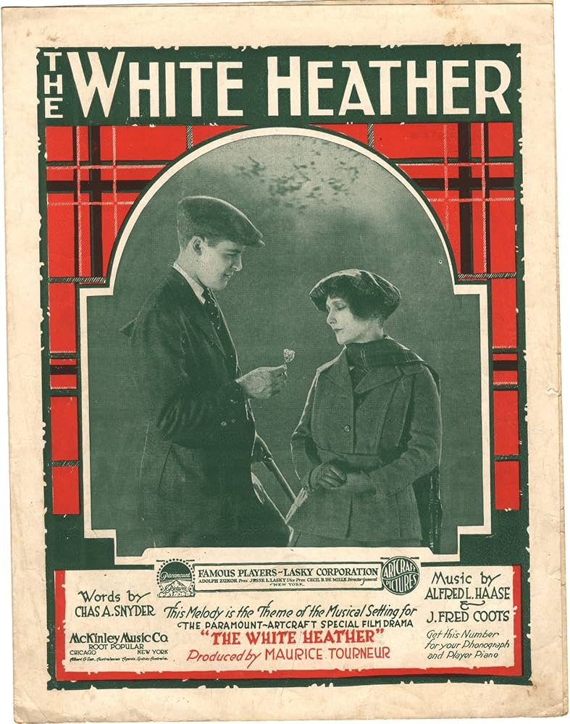
Thought to be a lost film, a copy of The White Heather was discovered at Eye Filmmuseum in Amsterdam in 2023. Its restoration was a collaboration between San Francisco Film Preserve, San Francisco Silent Film Festival and Eye
FilmmuseumBox.

