Slide 1

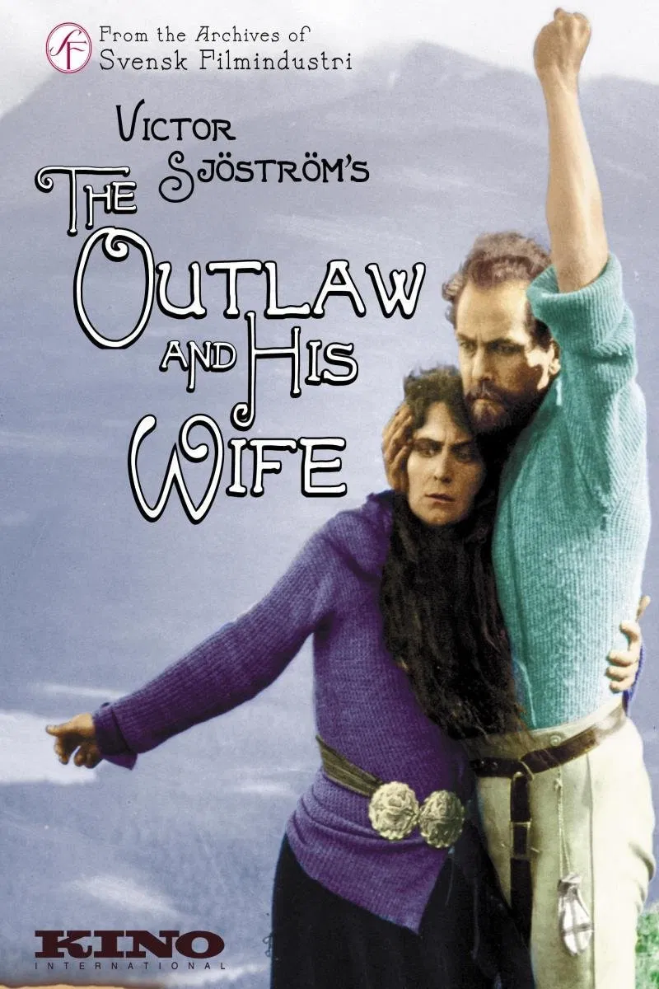
The Outlaw and His Wife
Berg-Ejvind och hans hustru
1918

Slide 2
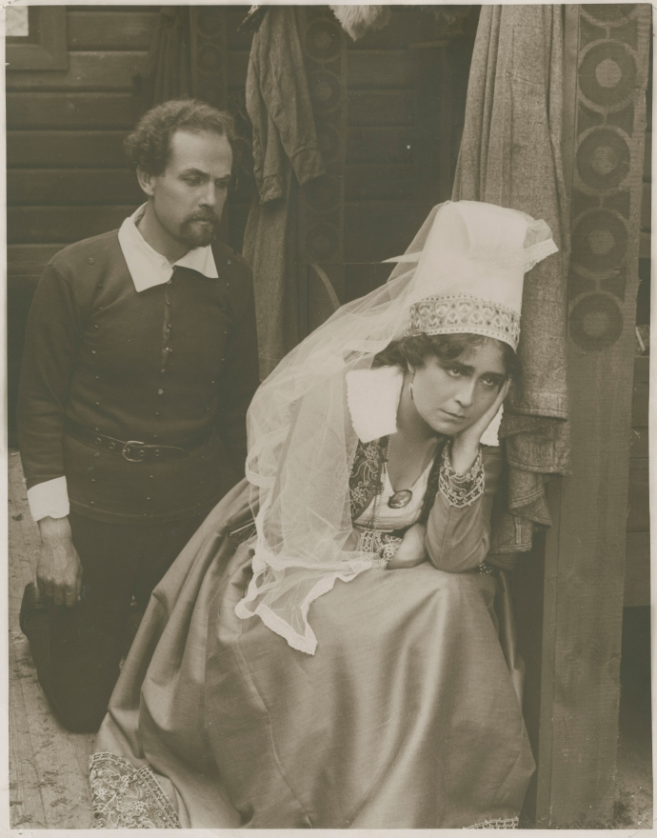
The film is based on a play from 1911 written by Jóhann Sigurjónsson, called Fjalla-Eyvindur (Eyvindur of the Hills).
The play in turn was inspired by the incredible true story of the Icelandic outlaw Fjalla Eyvindur and his wife Hella, who lived in the wilderness for 20 years in the late 1700’s.

Slide 3
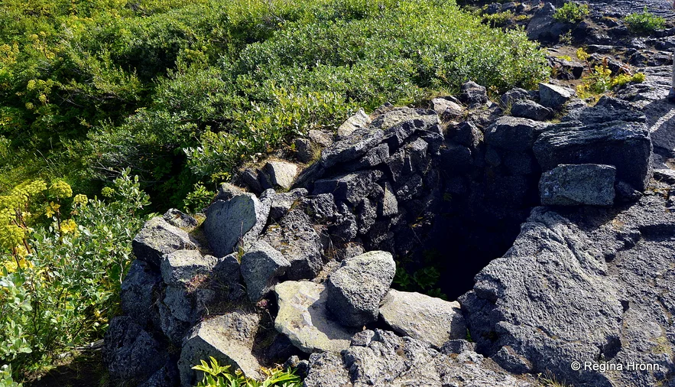
The real Eyvindur spent time in the highlands of Herðubreiðarlindir. It is still possible to see his underground shelter.

Slide 4
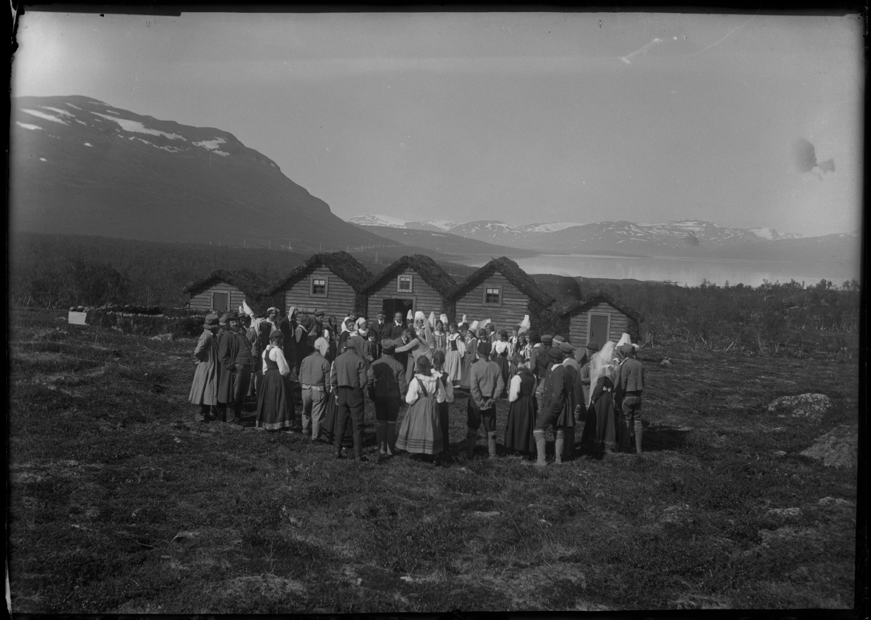
The film was shot in northern Sweden, the homeland of the director Victor Sjöström. Despite the freezing cold winters seen in the film, it was shot in spring and summer.

Slide 5
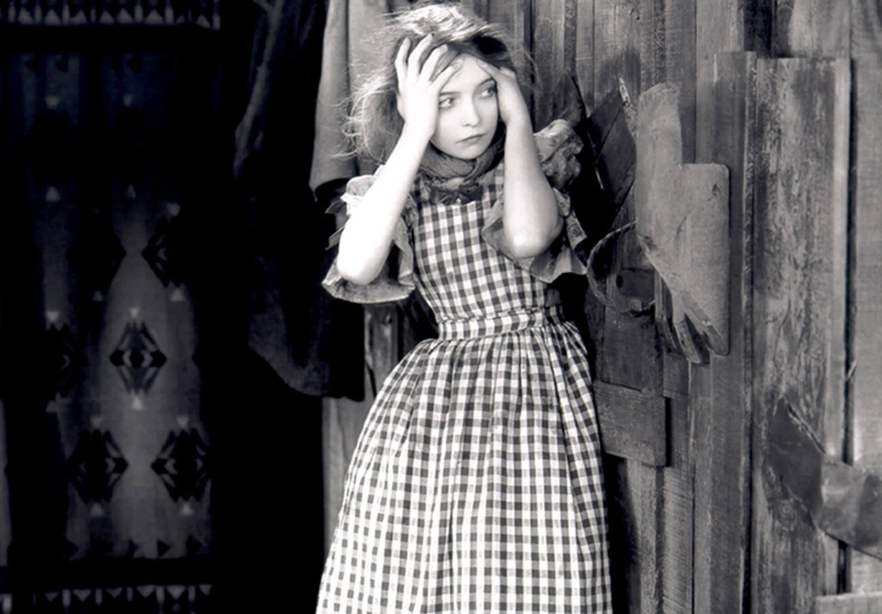
Sjöström moved to the United States in 1923 after accepting a contract with producer Louis B. Mayer. In Hollywood, he directed a number of famous stars including Greta Garbo, John Gilbert, and Lillian Gish.
Lillian Gish in The Wind (1928)

Slide 6
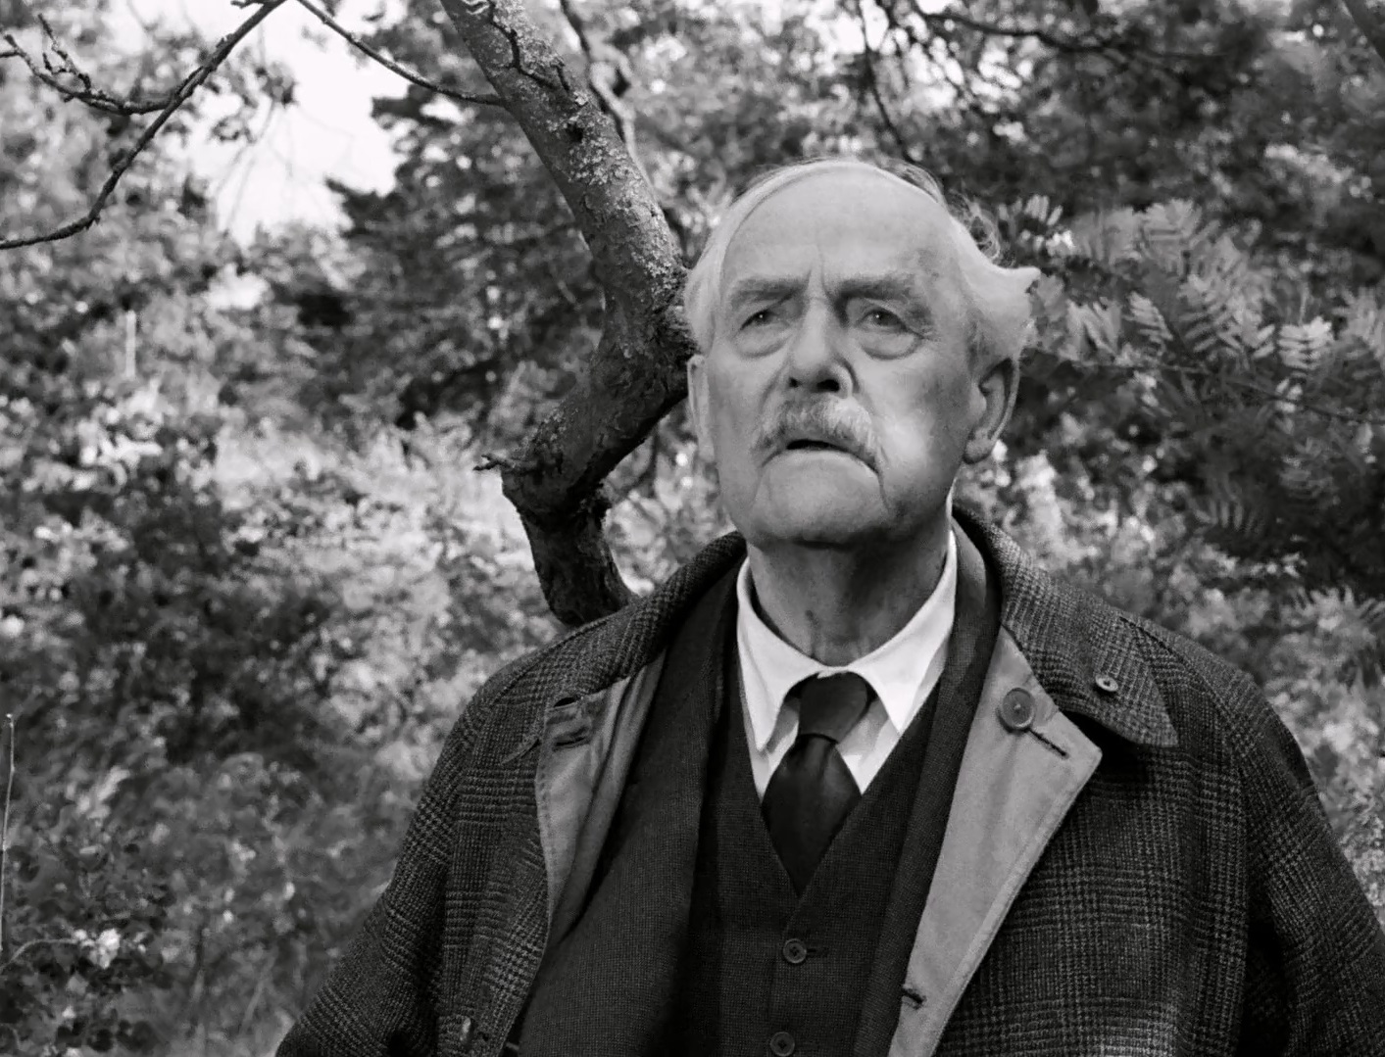
Sjöström himself stars in the film as the infamous outlaw. During his time in Sweden, he both acted in and directed films, but when he moved to Hollywood he focused his energy on directing. In later life, he starred in Ingmar Bergman’s Wild Strawberries (1957).

Slide 7
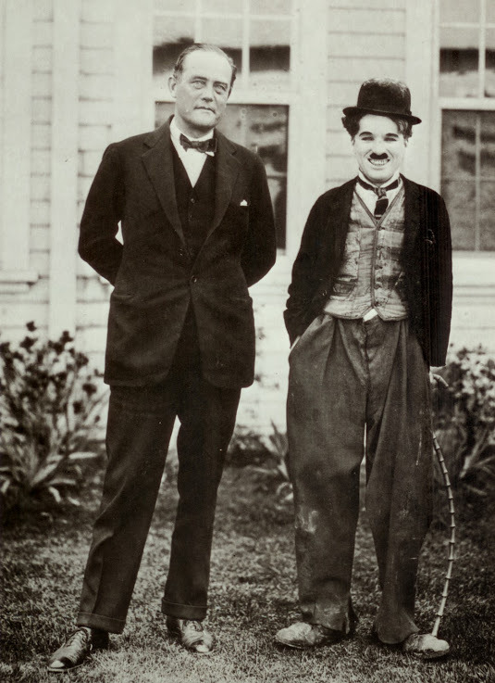
Unhappy with the advent of the talkie, Sjöström left Hollywood to return to Sweden in 1930. He only directed 2 more films before deciding to dedicate his time to theatre acting and leading the Svensk Filmindustri, Sweden’s largest film studio.
Sjöström and Charlie Chaplin during a visit to Chaplin Studios in 1925.

Slide 8
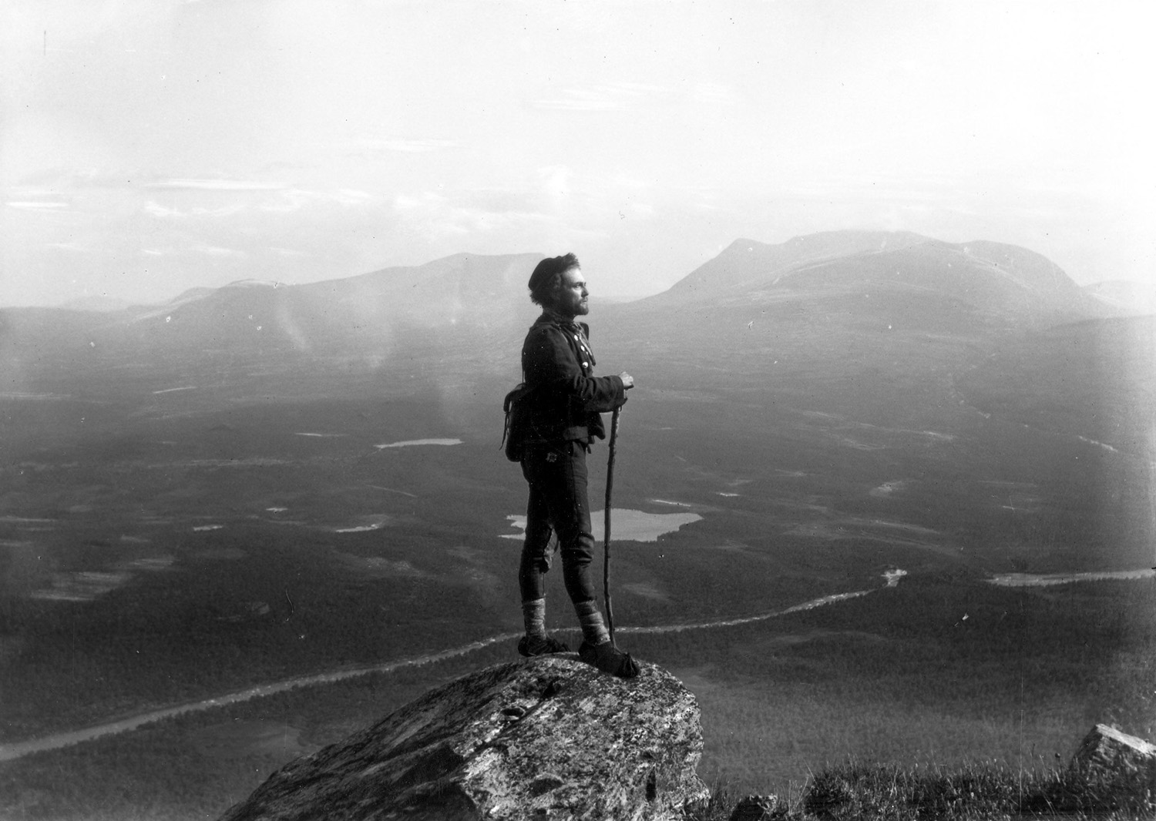
Sjöström did all of his own stunts for the film, including the nail-biting cliff scene. Although he was secured by a hidden cable, the hook holding the cable to the cliff broke at the last second, and he would have plunged to his death if not for a quick rescue by a crew member.

Slide 9
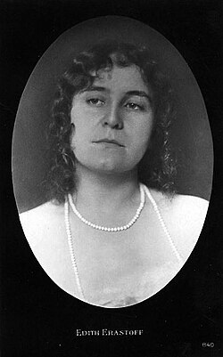
Edith Erastoff, who stars alongside Sjöström as Eyvind’s wife Hella, actually married Sjöström in 1922. At the time of filming, she was pregnant with their daughter, Guje Lagerwall, who went on to become an actress herself.

