Slide 1

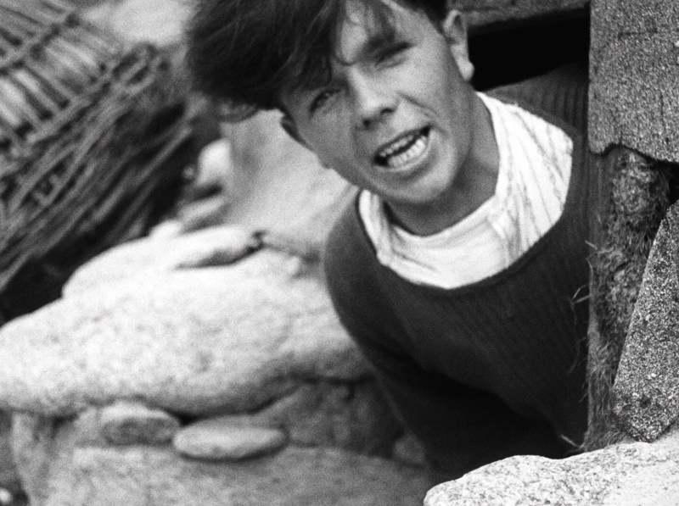
Finis Terræ
Jean Epstein
(1929)

Slide 2
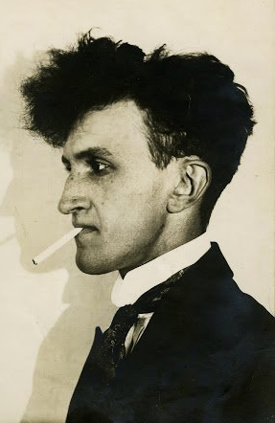
Jean Epstein was born in Warsaw (part of the Imperial Russian Empire) in 1897. He was raised in Switzerland by a Polish father and a French mother.
As a child, Epstein was terrified of the cinema due to stories of the freak immolation of a local bishop at a cinema, writing in later life: “In my premature logic, I told myself that if a bishop can die at the cinema, all the more reasonable that I would, since I was surely not so well protected by the will of God”.
A teenage love for Chaplin films, shared by him and his sister, Marie, soon relieved him of any fears.

Slide 3
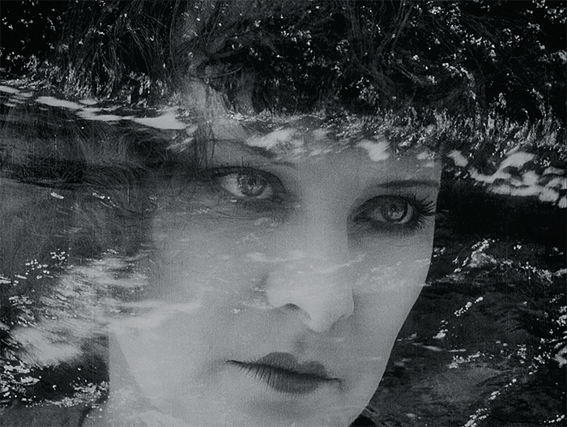
In 1914, Epstein moved to Lyon, originally to pursue medicine. Here, he worked as a secretary for one of the forefathers of cinema: Auguste Lumière.
Epstein started directing his own works in the early 1920s. His early films, such as Cœur fidèle (1923), often attempted to combine avantgarde aesthetics with working-class melodrama.
In 1926, he founded his own film company, Les Films Jean Epstein.
Cœur fidèle (1923)

Slide 4
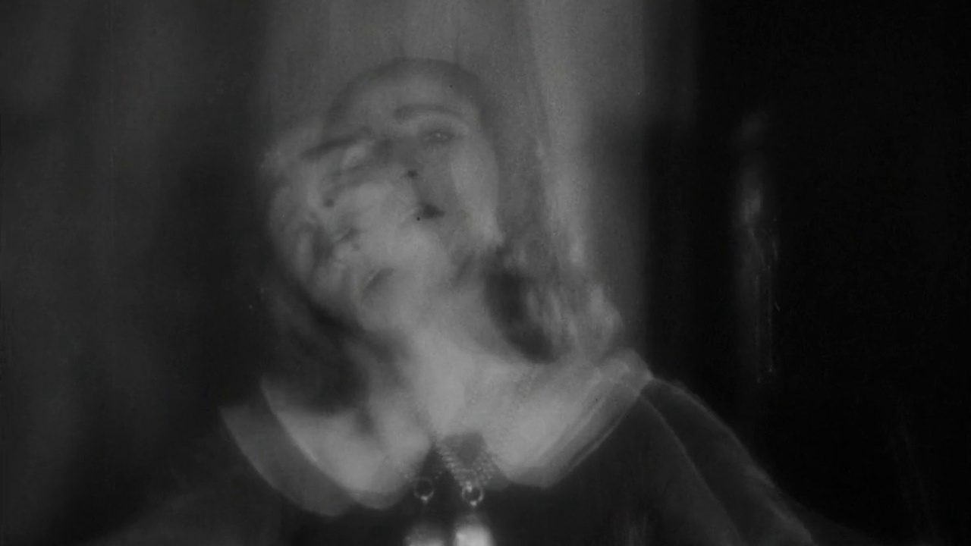
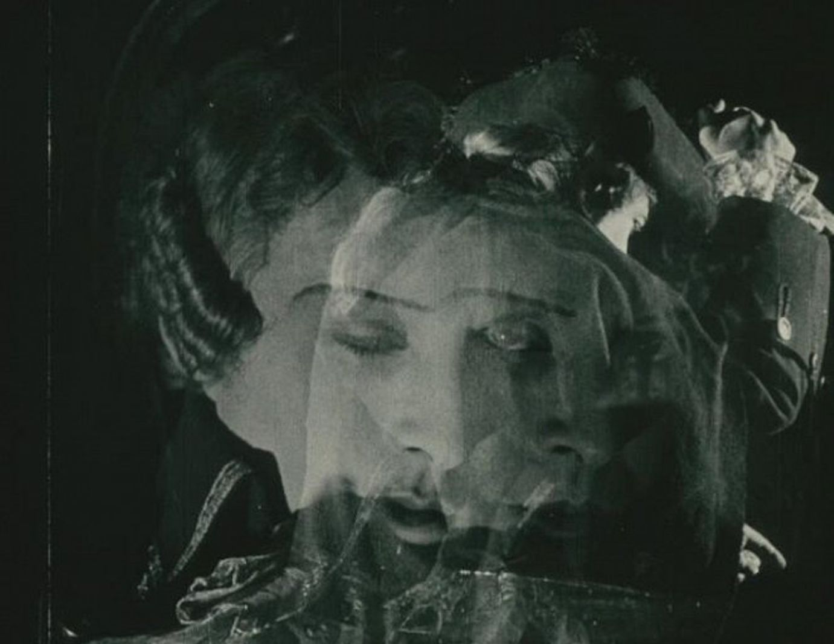
Epstein belonged to the avantgarde but was suspicious of its surrealist and abstractionist tendencies.
Nevertheless, surrealist filmmaker Luis Buñuel was the assistant director of two of Epstein’s films – Mauprat (1926), and The Fall of the House of Usher (1928).
During the making of their last film, Buñuel and Epstein’s working relationship imploded.
The Fall of the House of Usher (1928)
Mauprat (1926)

Slide 5
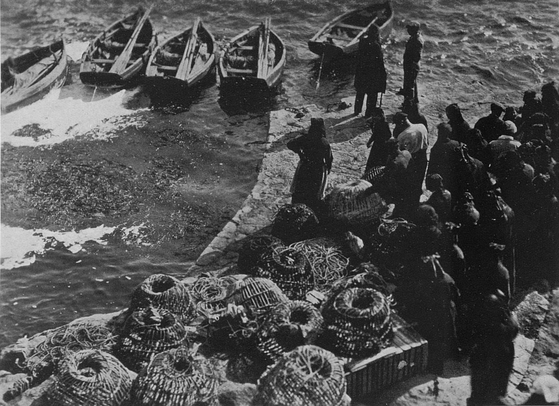
After The Fall of the House of Usher, Epstein wrote that it was “impossible to further capture the real using the unreal.”
Finis Terræ was thus a turning point, and his “attempt to get past this dead end” by hybridising his cinematic impulses – poetic experimentation and documentary.
Scorned by the French intelligentsia, and stranded by increasingly commercial cinema, he entered a period of financial crisis.
Finis Terræ (1929)

Slide 6
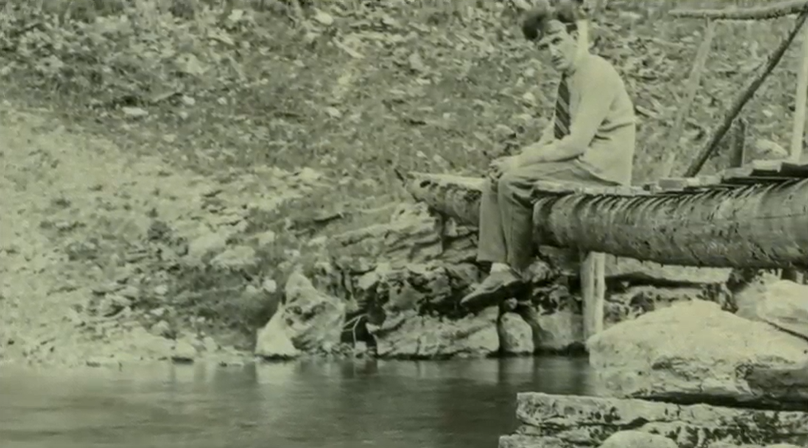
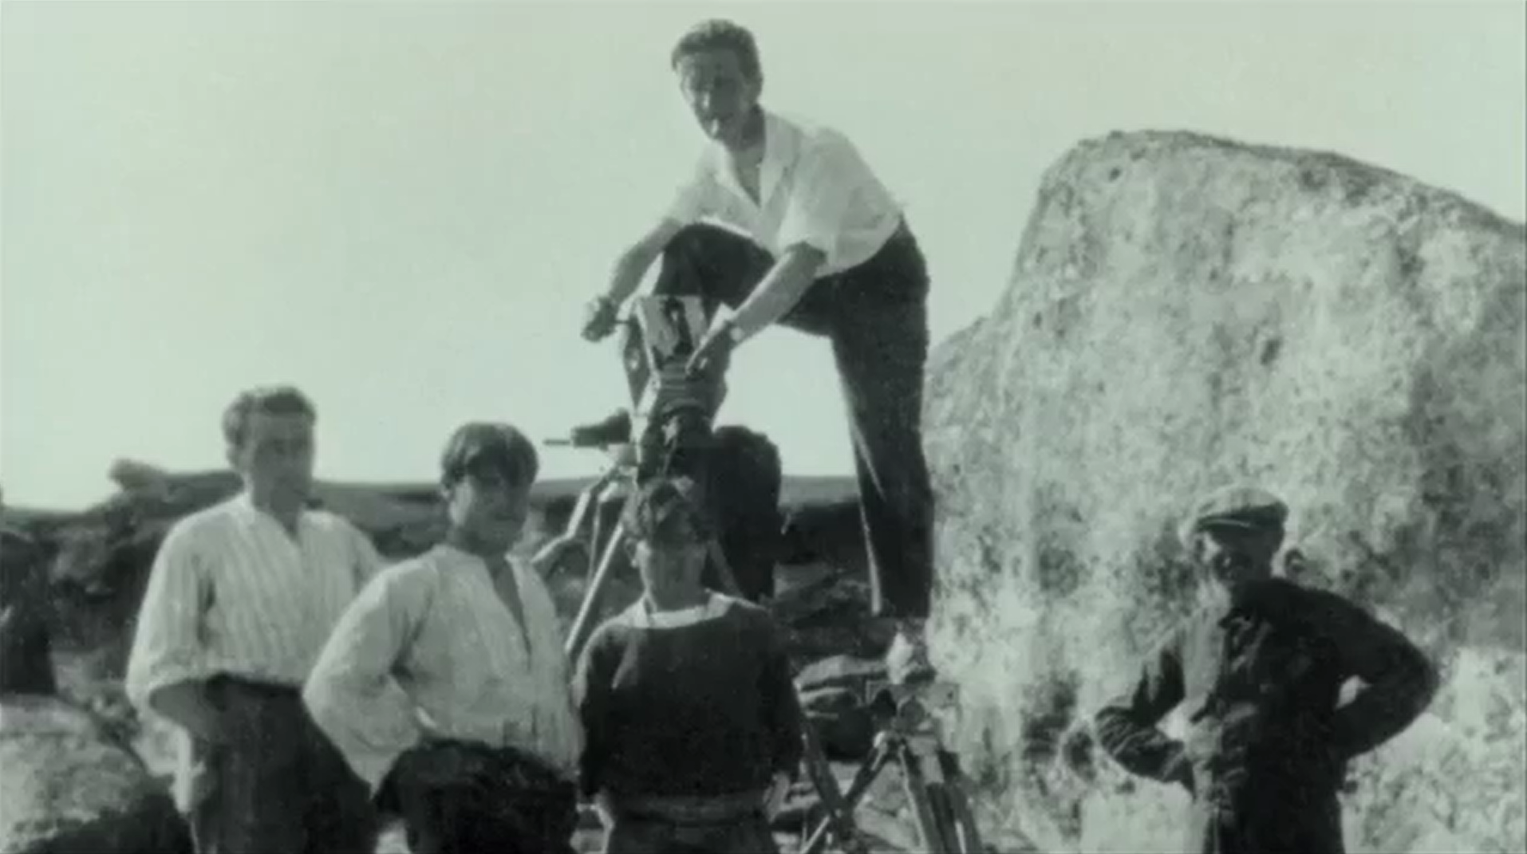
With debts looming, Epstein travelled to the Ouessant in 1928.
He was drawn to the culturally distinct coastal communities of Brittany – their geographical remoteness, the use of Breton (a Celtic language), an imperviousness to industrial modernity, and of course, the sea.
It took time for Epstein and his skeleton crew to gain the trust of locals, but eventually he was able to shoot with the local non-professional actors, who helped develop the script.
Archival material from the film Jean Epstein, Young Oceans of Cinema (2011)

Slide 7
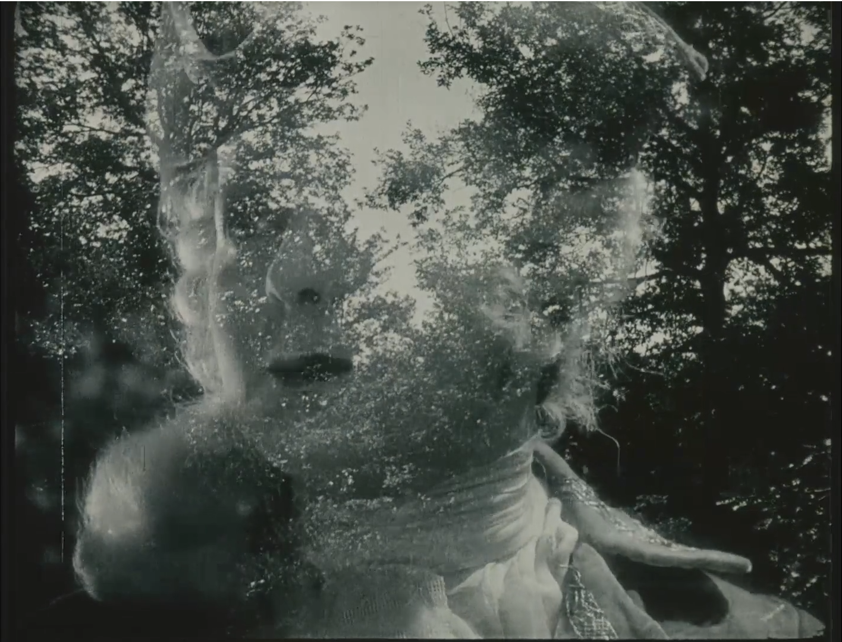
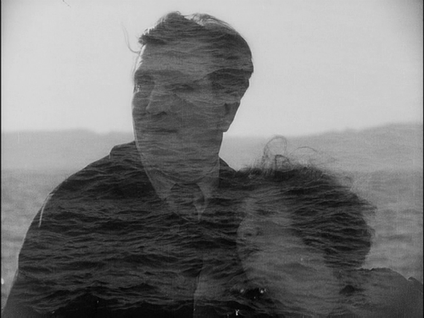
Central to Epstein’s films was the concept of ‘photogénie’, described as a form of animism in which our perception of the material world is transformed through the camera to intense affect.
Epstein wrote: “On screen, there is no still life. Objects take on airs. Trees gesticulate. Mountains…signify. Each element of staging becomes a character.”
As a modernist, he believed cinema’s task was to become purely cinematic – to employ techniques such as slow motion, close-ups, and superimposition to reveal that which is photogénic.
Mauprat (1926)
Cœur fidèle (1923)

Slide 8
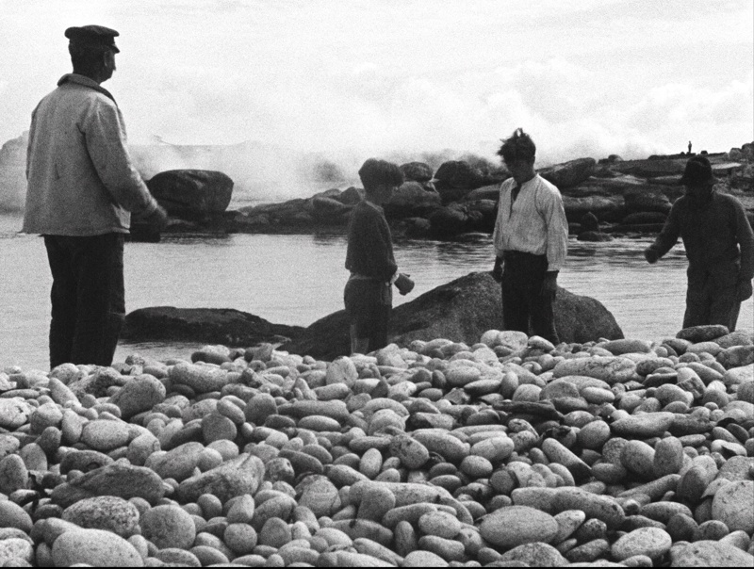
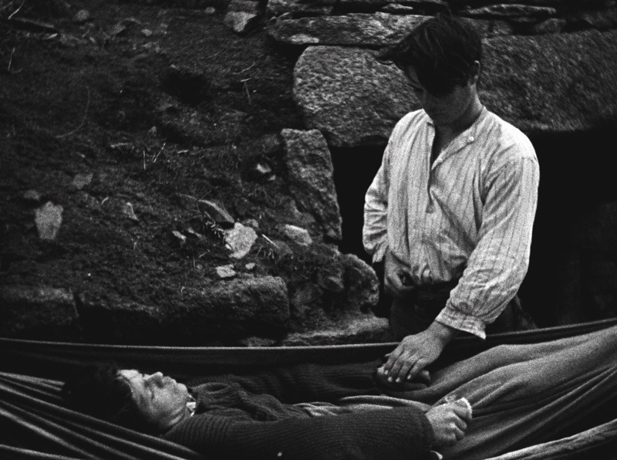
Epstein maintained that Finis Terræ (named after the region Finistère and meaning End of the Earth), was not documentary, but “fact”.
Critics responded largely positively to the release of Finis Terræ. One review, from The Manchester Guardian, remarked: “it has a beauty and dignity which is rare, and a rhythm which is M. Epstein’s gift.”

Slide 9
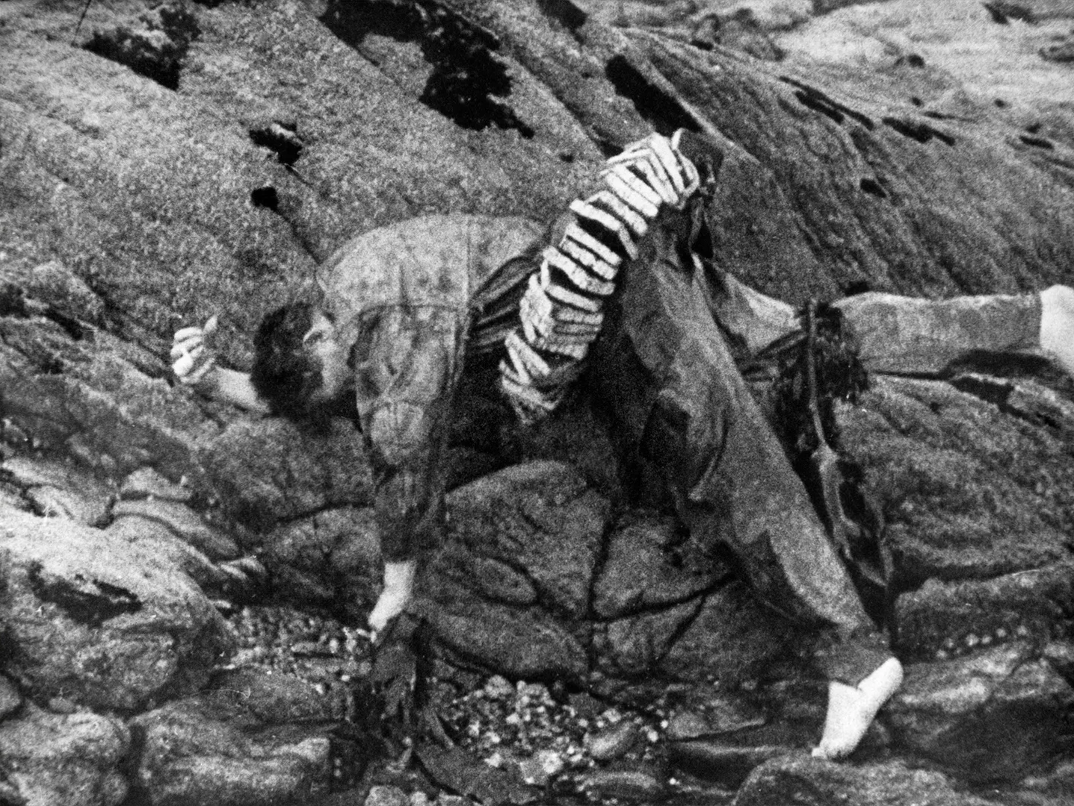
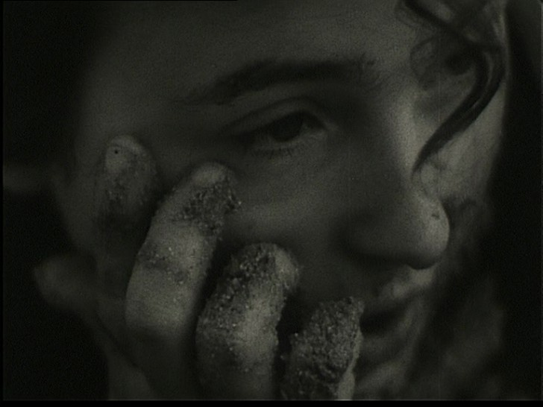
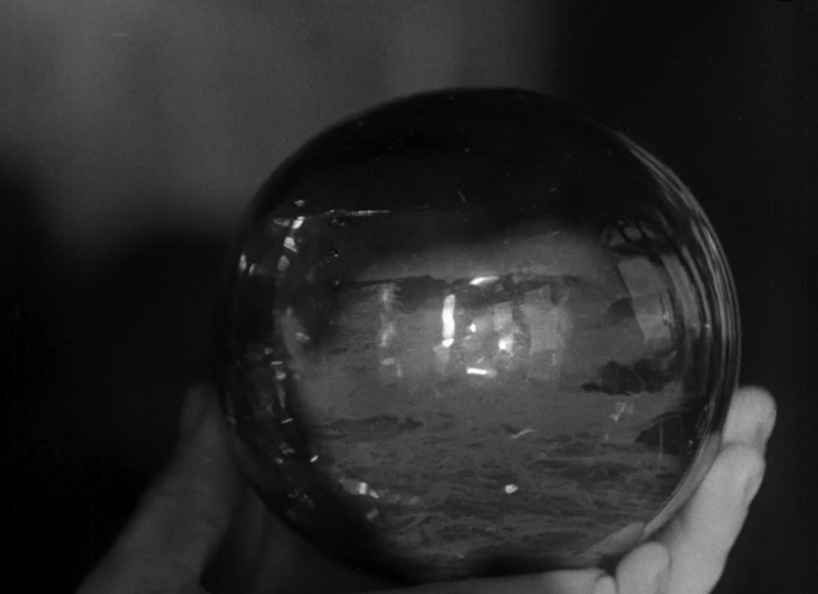
Mor’vran (1930)
L’Or des mers (1932)
Le Tempestaire (1947).
Despite Epstein’s belief that the island “lost some of its magic” through its on-screen projection, he returned to put Brittany’s islands on film four more times in Mor’vran (1930), L’Or des mers (1932), Le Tempestaire (1947), and Les feux de la mer (1949).

Slide 10
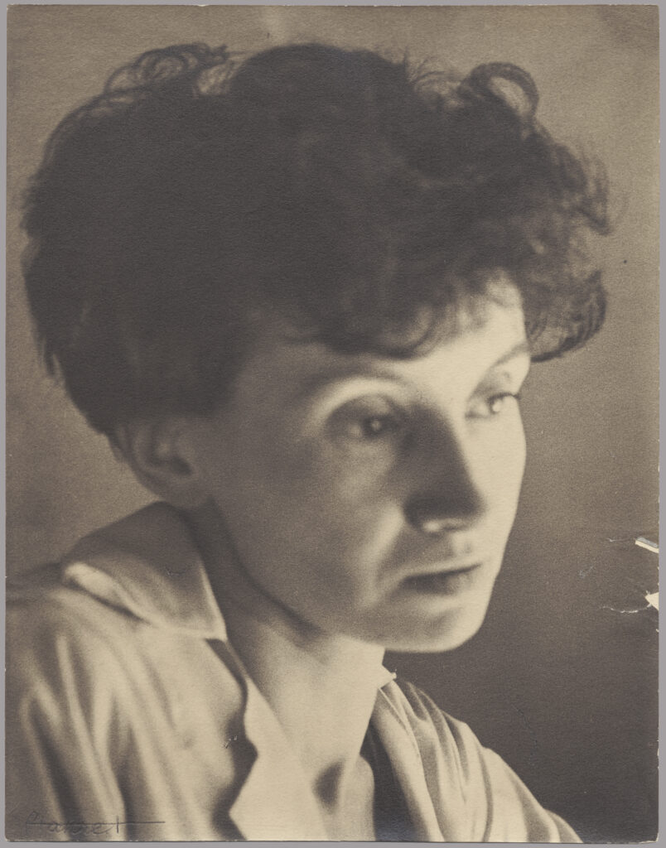
Although a Catholic, Epstein had a Jewish father. Considered Jewish by the racial criteria of the Vichy government, Epstein was banned from any studio work during the German occupation of France.
  Epstein and his sister, and frequent collaborator, Marie, were arrested by the Gestapo in 1944, only evading deportation through the intervention of the Red Cross.
  Epstein’s films were hidden from the Nazi authorities by his friends, filmmaker Germaine Dulac and archivist Henri Langlois.
Marie Epstein (1899-1995), an actress, film preservationist, screenwriter, and director in her own right.

Slide 11
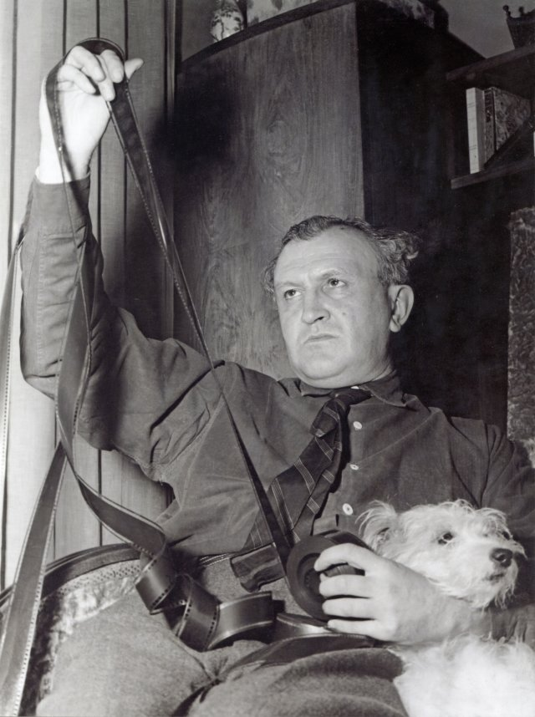
When Henri Langlois founded the Cinémathèque Française in 1936 – with help from Marie – the first print he acquired was The Fall of the House of Usher.
Jean died in 1953. The same year, Marie started work as a technical director restoring avantgarde film for the Cinémathèque.
At this time, Jean Epstein’s films were rarely screened. Only in the late 1990s did his reputation revive, when the opening of his personal archive revealed manuscripts, letters, and a pseudonymous treatise on ‘Masculine Homosexual Ethics’ from the 1930s.

