Slide 1

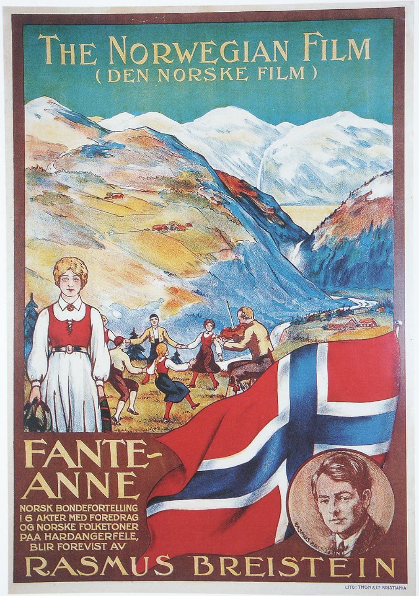
Fante-Anne
Rasmus Breistein
1920
A pioneering romantic melodrama filmed in beautiful rural Norway.

Slide 2
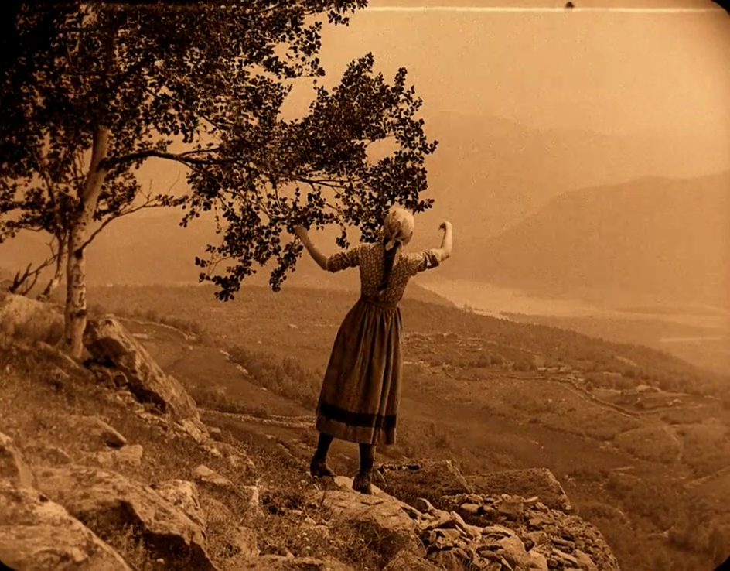
Fante-Anne is the first professionally made Norwegian film. Both the cast and crew consisted of professionals.

Slide 3
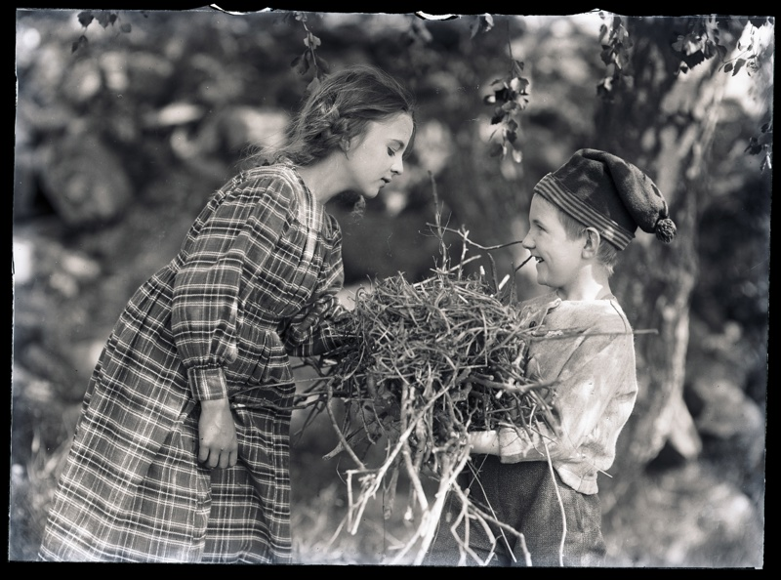
Many previous Norwegian films were made alongside crew from other countries, primarily other Scandinavian nations and Germany.
Fante-Anne, however, involved Norwegians at every stage of production.

Slide 4
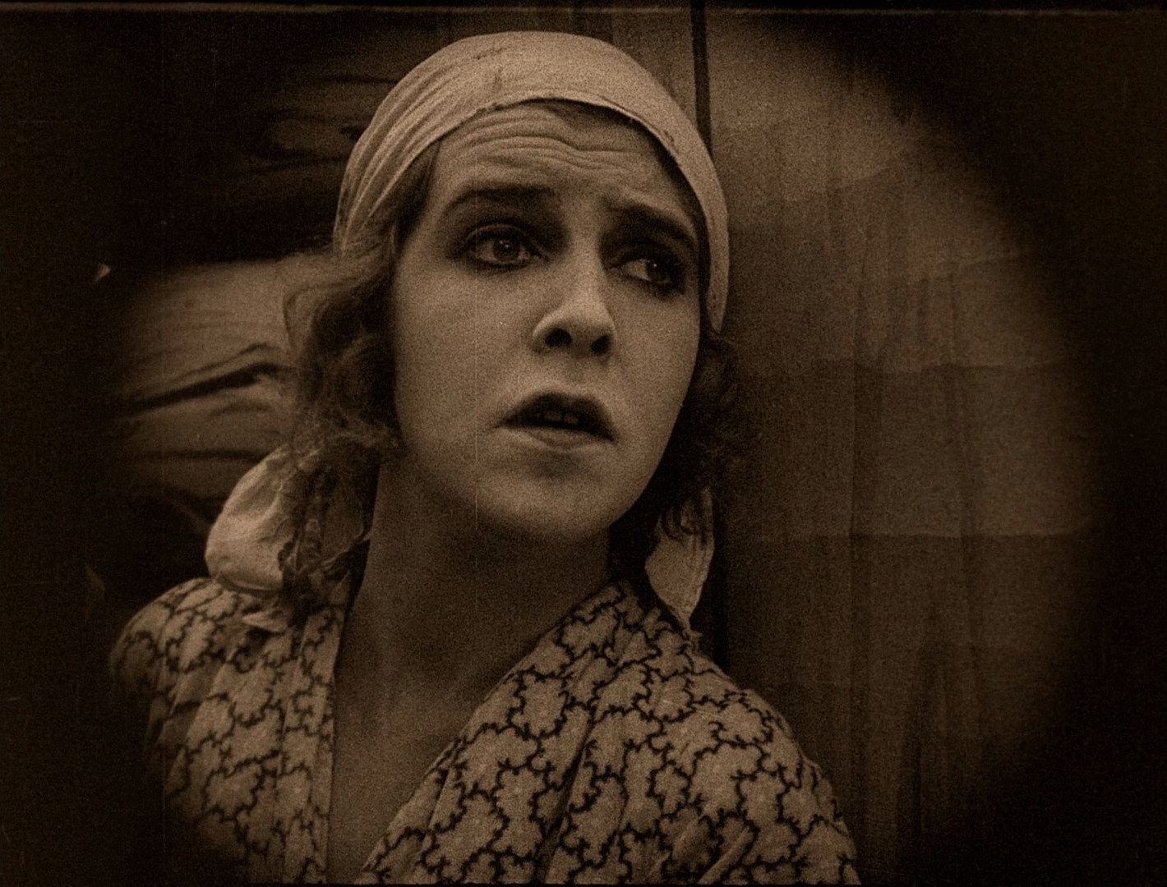
The film stars Aasta Nielsen in her screen debut. Nielsen was primarily a theatre actress and featured in three films between 1920 and 1921.
Despite their strikingly similar names, Aasta Nielsen is of no relation to Danish silent screen icon Asta Nielsen.

Slide 5
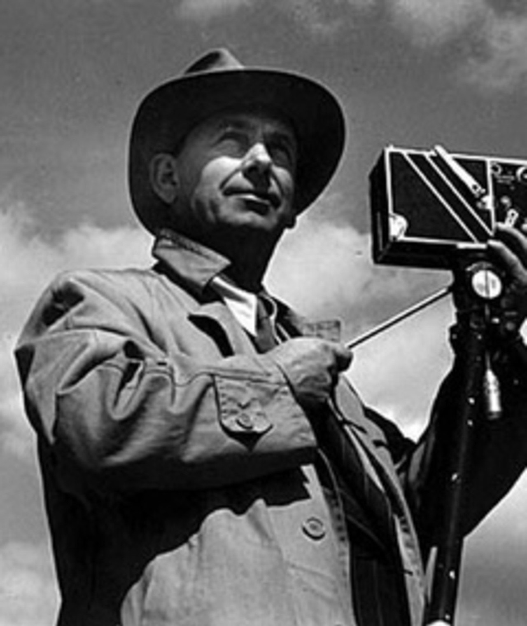
The film was directed by another figure involved in theatre, Rasmus Breistein.
Fante-Anne was his debut feature film.

Slide 6
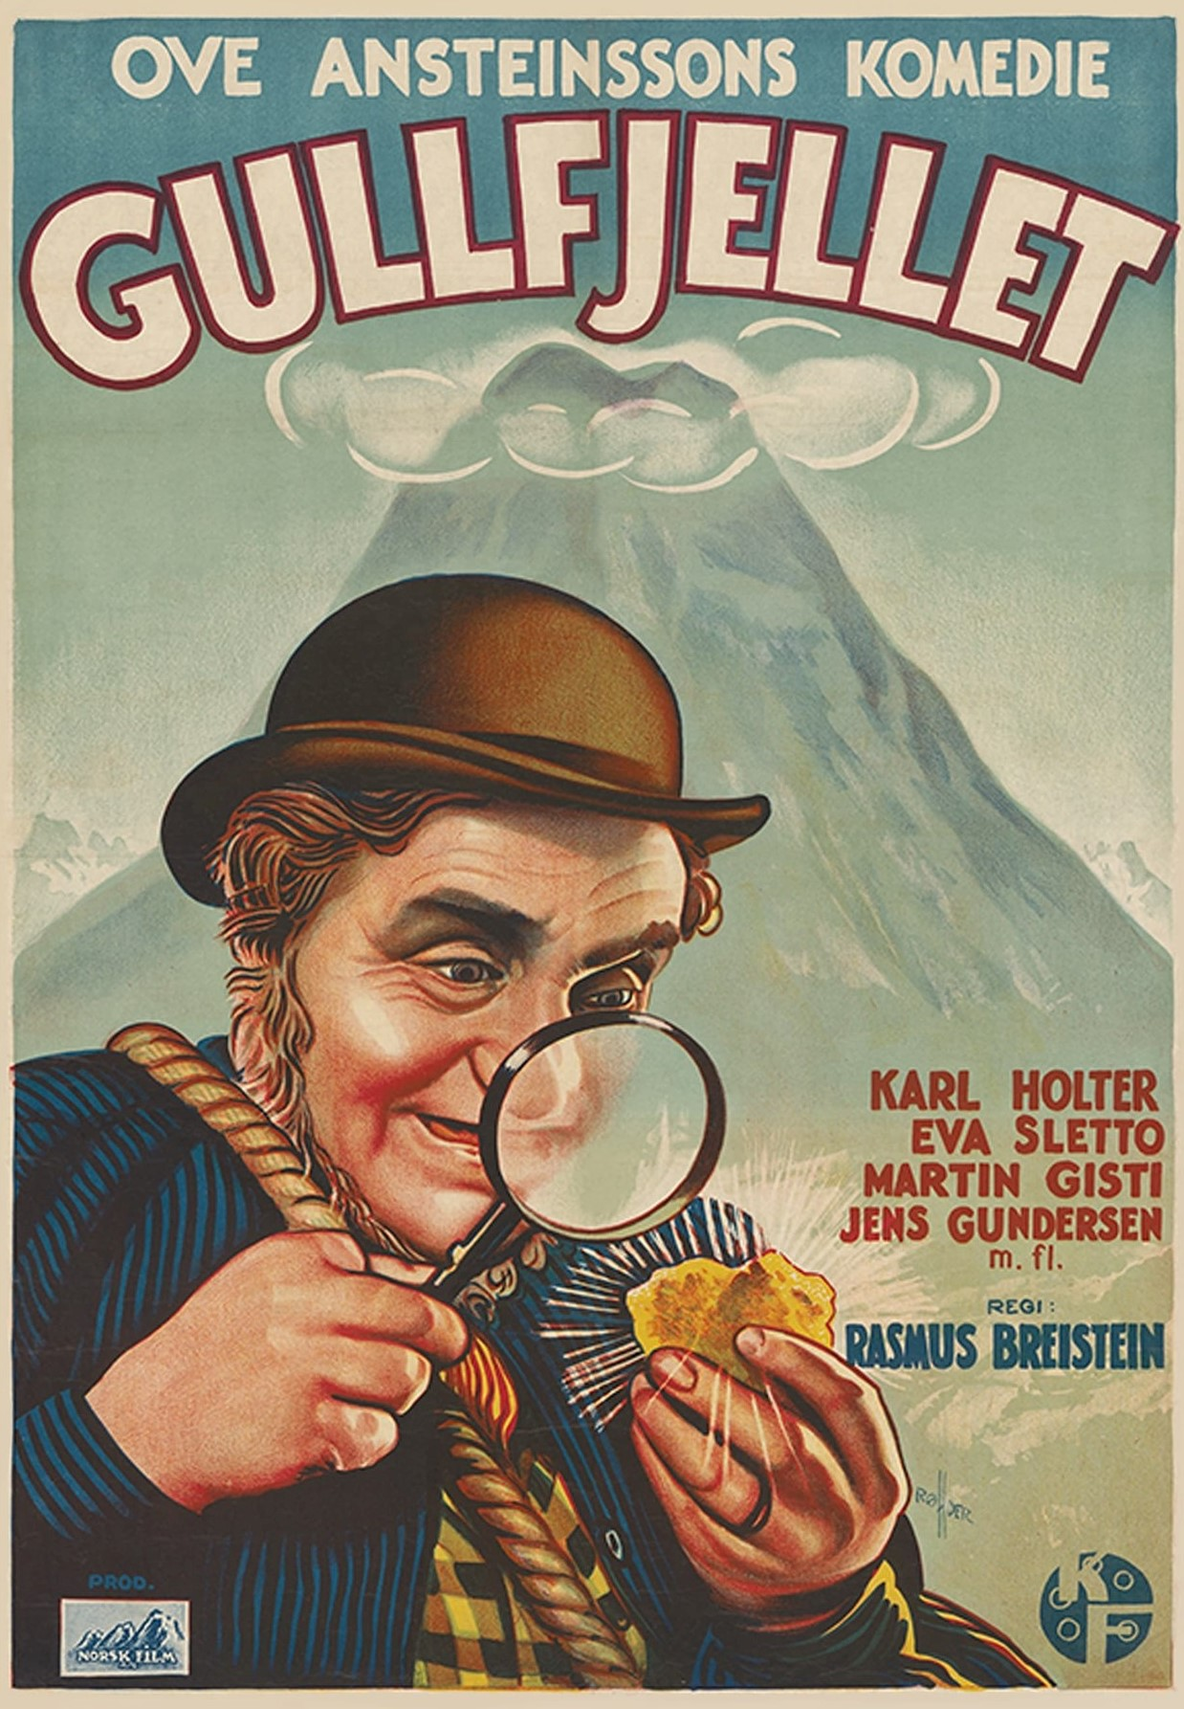
Breistein was an extremely influential figure in the Norwegian silent film industry and continued to be a prominent filmmaker in the sound era.
He would continue to direct films until the early 1950s.

Slide 7
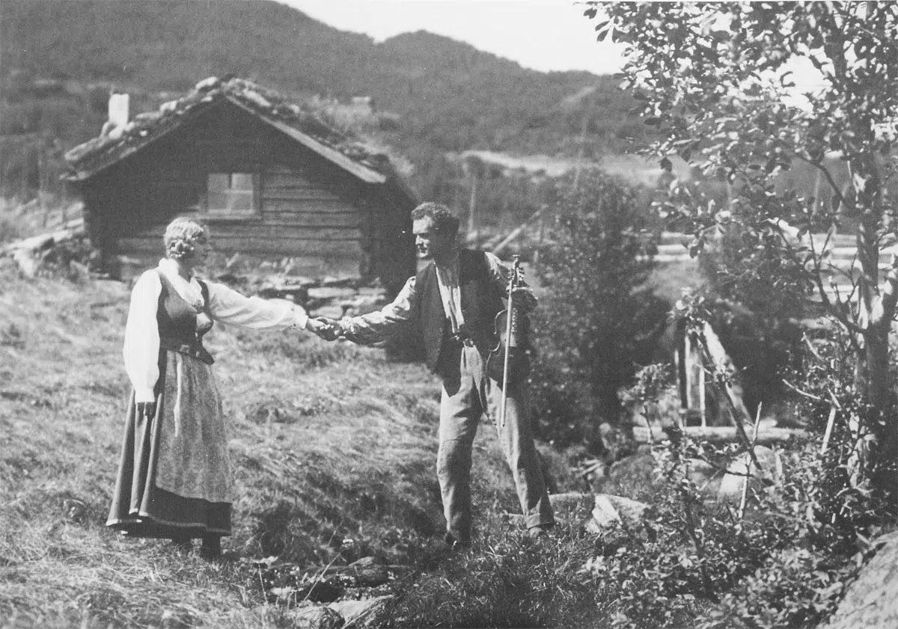
Breistein’s entry into the film industry was largely borne out of a frustration with the state of Norwegian film.
Swedish filmmakers would make films based on Norwegian stories as their industry was larger and more advanced.

Slide 8
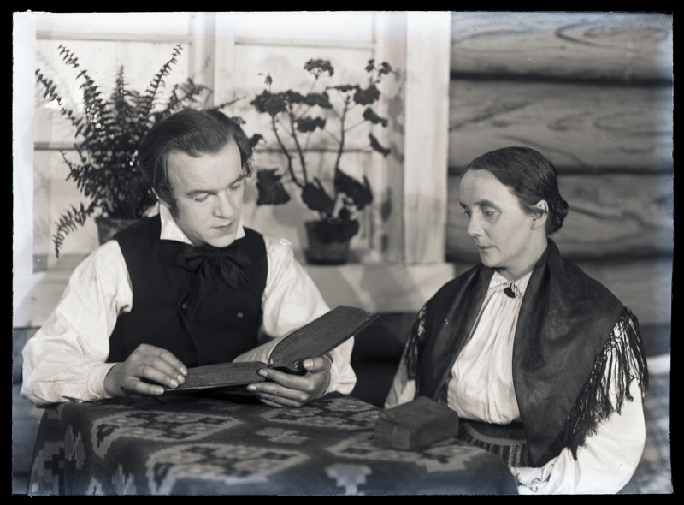
Fante-Anne was a major turning point for the perception of Norwegian cinema.
For comparison, an article in ‘Film Og Kino’ from two years before Fante-Anne’s release proclaimed “It is so sad for the country that our films should be so dreadful”

Slide 9
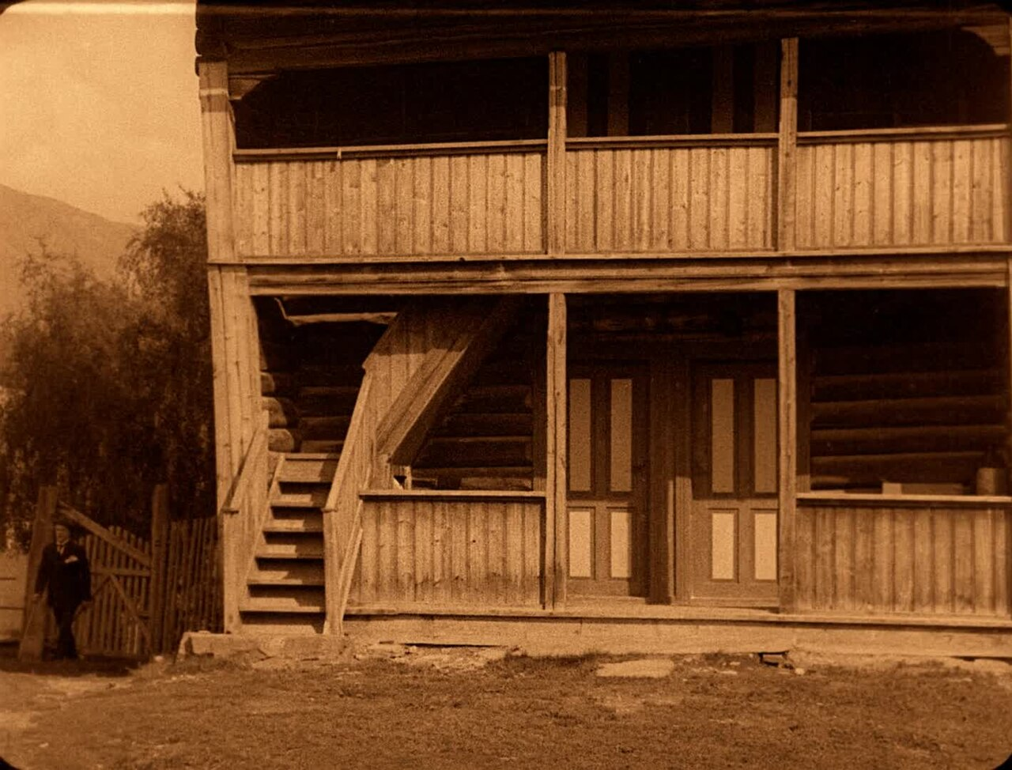
Many themes from Fante-Anne, such as the featuring of traditional Norwegian dress, folk music, rural settings and melodrama would become major parts Norwegian cinema during the interwar period.

Slide 10
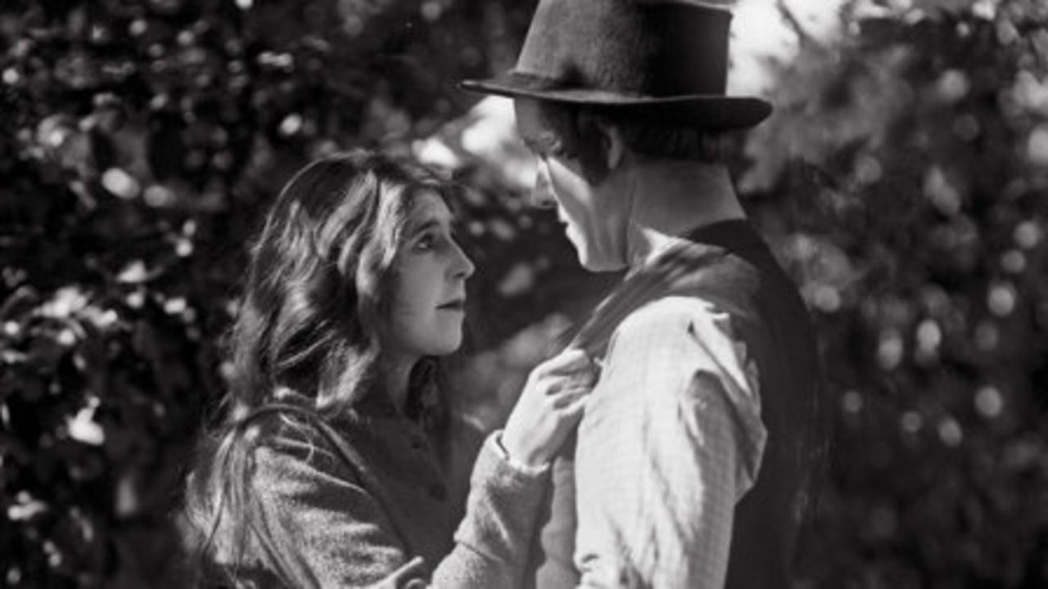
In the film’s original run director Rasmus Breistein, a keen fiddle player since childhood, would accompany the film himself.

