Slide 1
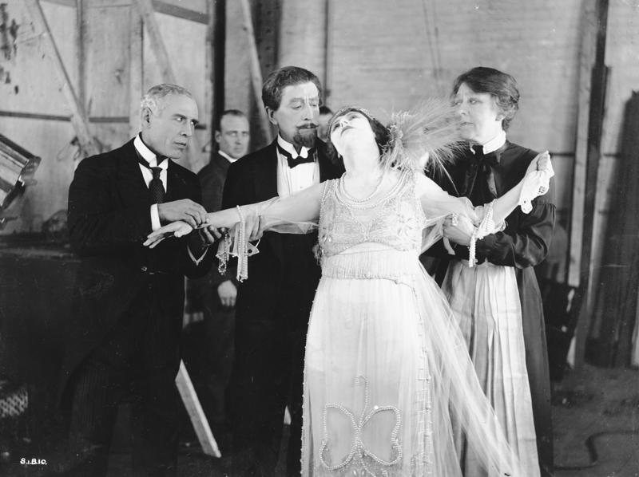
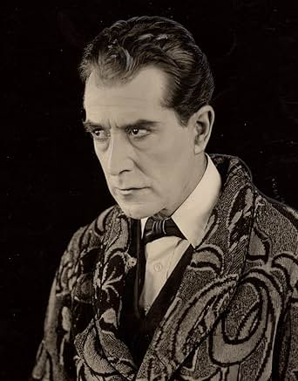
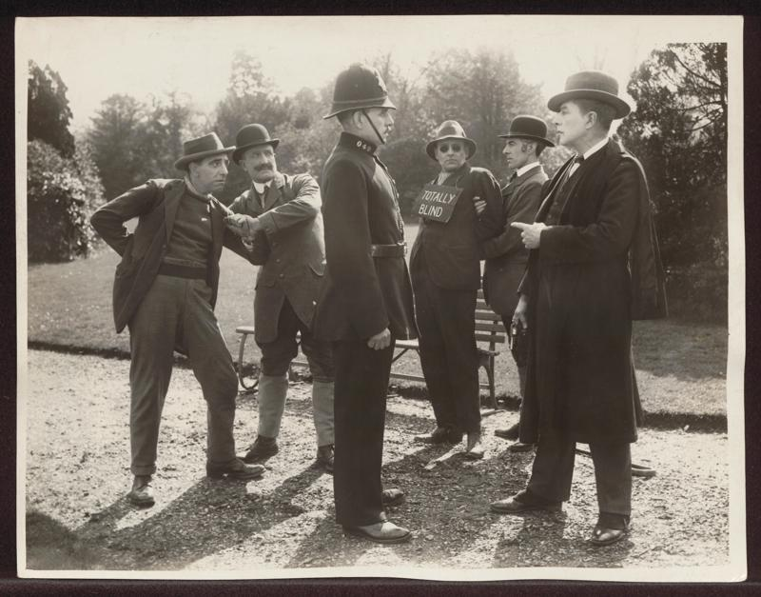
Silent Sherlock:
Three Classic Cases
A Scandal in Bohemia Dir. Maurice Elvey (1921)
The Golden Pince-Nez Dir. George Ridgwell (1922)
The Final Problem Dir. George Ridgwell (1923)

Slide 2
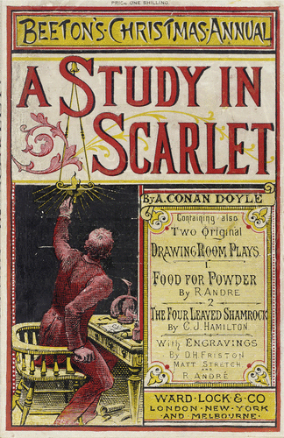
Sherlock Holmes first appeared in Arthur Conan Doyle’s novel, A Study in Scarlet, originally published by Ward, Lock & Co. in the 1887 edition of Beeton's Christmas Annual.
Holmes canonically appeared in three more novels and 56 short stories published in the Strand Magazine between 1891 and 1927.

Slide 3
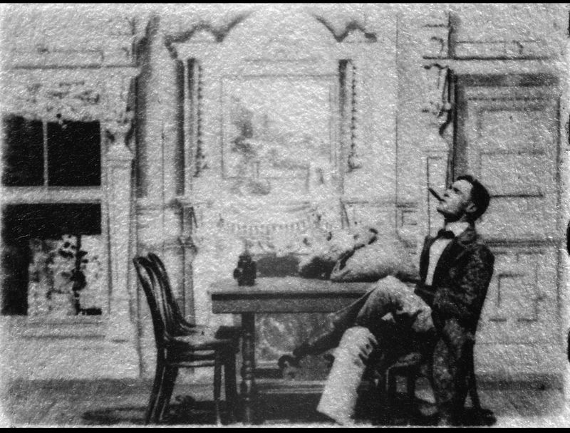
The detective first appeared on screen in the one-minute short, Sherlock Holmes Baffled (1900). The silent trick film, in which Holmes is robbed in his residence, bears no relation to stories in Conan Doyle’s canon.
The film was directed by Arthur Weed Marvin, one of the founders of the American Mutoscope and Biograph Company, who shot around 418 films between 1897 and 1911.

Slide 4
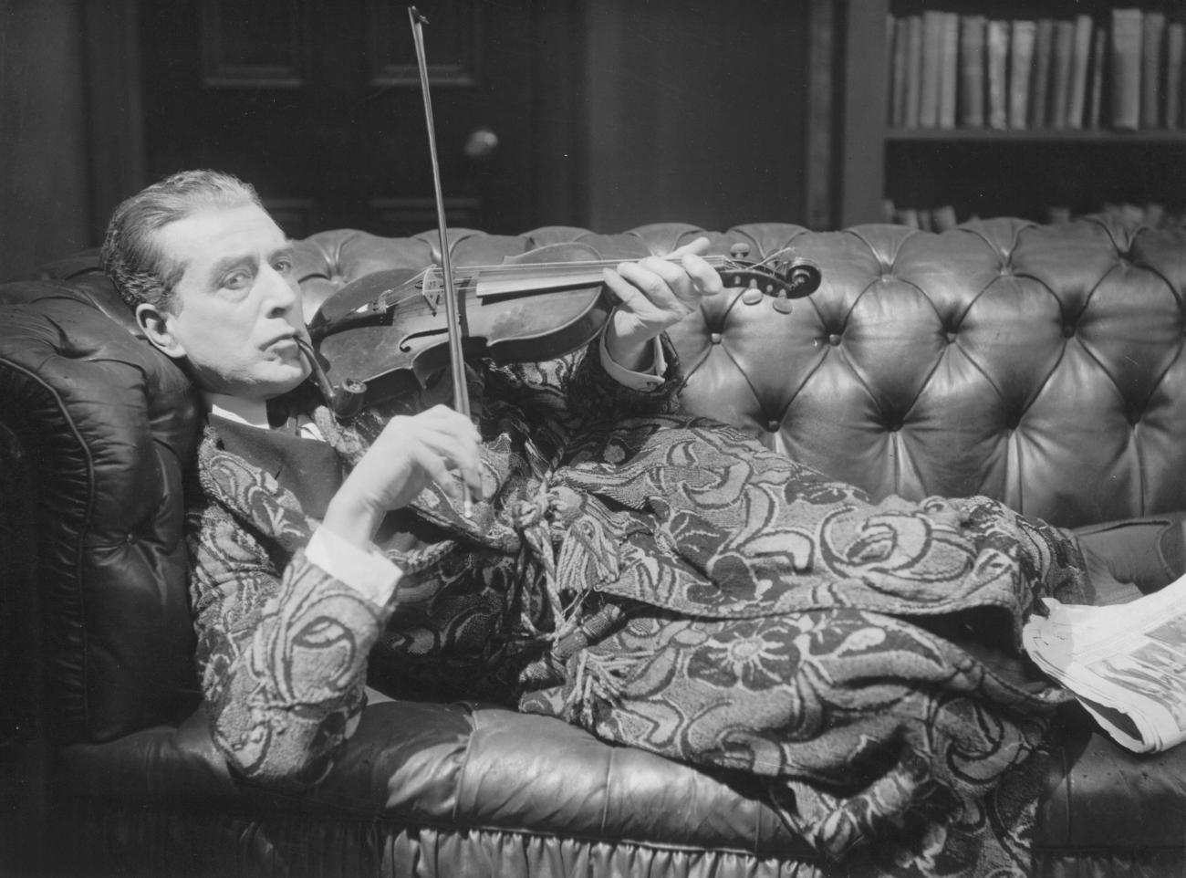
The Conan Doyle-approved Eille Norwood, who played Holmes in the 45 two-reelers and two features produced by Stoll between 1921 and 1923, still holds the record for appearing as the character more times than any other actor on the big screen.
Norwood also played Holmes on the London stage in the 1923 play The Return of Sherlock Holmes.

Slide 5
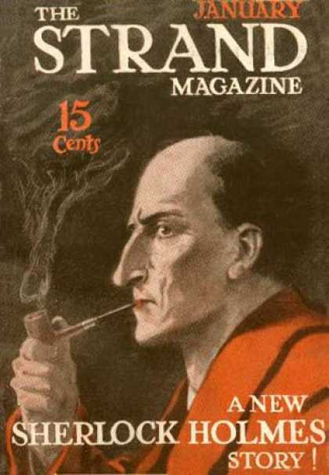
The National Archives hold files with various correspondences to Scotland Yard asking if Sherlock Holmes was in fact a real person.
One such letter from ‘a Citizen of Revolutionary Russia’, Timothy Kozynitch Bogdarenko, on 8th August 1917 states, ‘I have now conclusively established that this personage in fact exists at the present time’.
Despite being fictional, such enquiries speak to the widespread and enduring popularity of the 221B Baker Street detective.

Slide 6
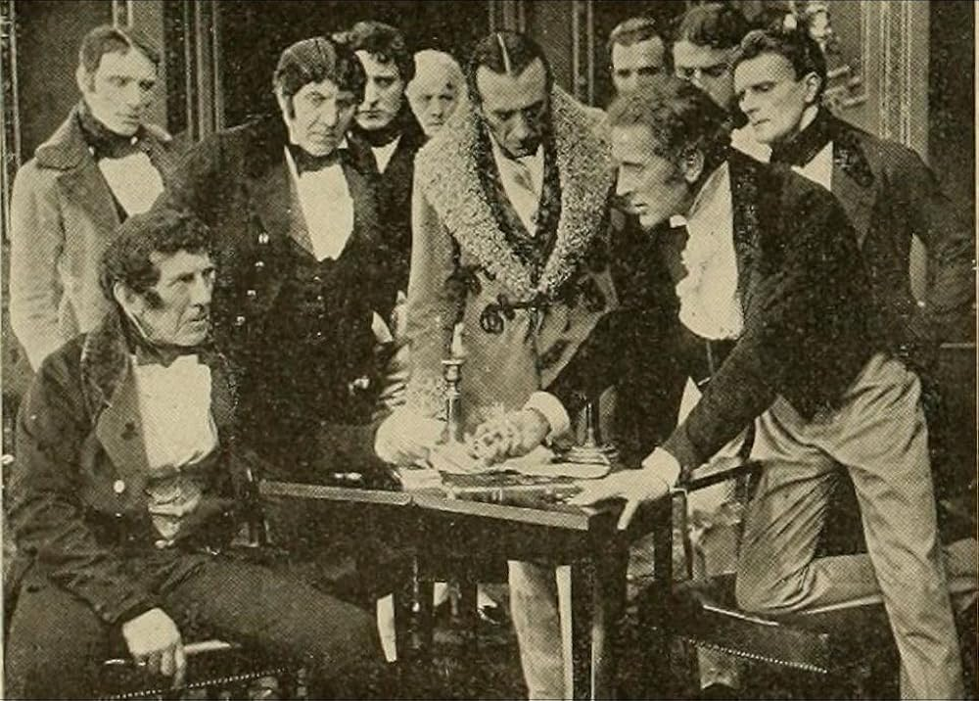
Hubert Willis appeared as Dr John Watson in all but one of the Stoll adaptations, being replaced by Arthur Cullin in the later feature, The Sign of Four (1923).
Earlier in his career, Willis starred in The House of Temperley (1913), another film adaptation of Conan Doyle’s work based on his 1896 novel Rodney Stone.

Slide 7
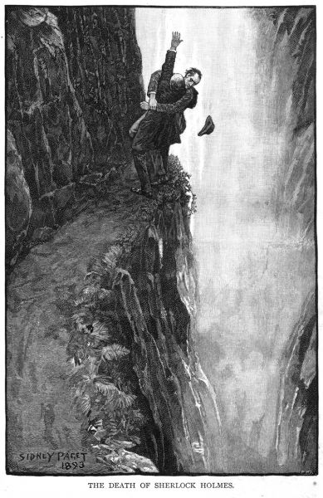
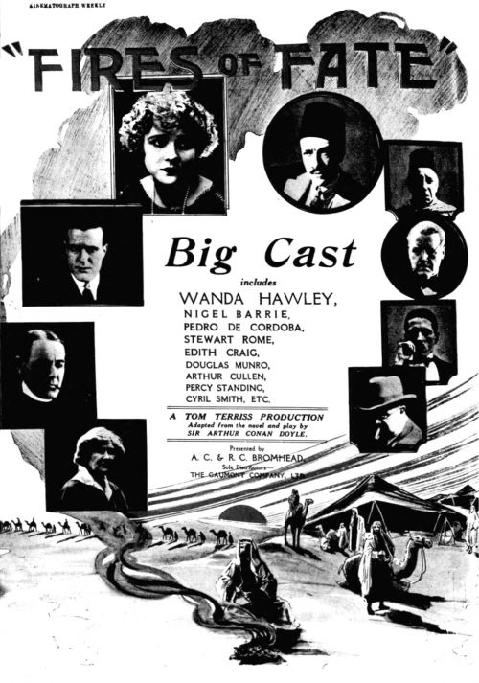
In The Final Problem (1923), Holmes meets and confronts his nemesis Professor Moriarty, played by Percy Standing.
In the same year, Standing also appeared in the silent film, Fires of Fate (1923), an adaptation of the 1909 play which was in turn based on another Conan Doyle novel, The Tragedy of the Korosko (1898).

Slide 8
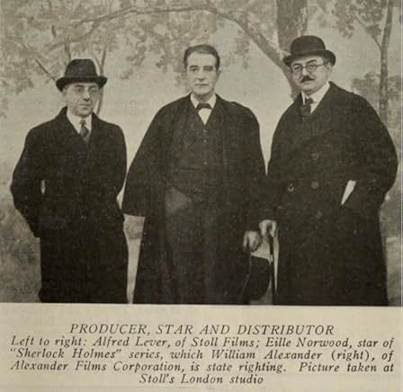
The Stoll Film Company, which produced and distributed these films, was founded in April 1918 by Sir Oswald Stoll, a major British theatre figure who oversaw the London Coliseum and produced the first Royal Variety Performance in 1912.
Stoll was, at its height, the largest UK film production company but suffered at the advent of the ‘talkies’ despite making several sound films in the late 1920s to early 1930s. The studio closed in 1933 after the release of its final film, Dick Turpin.

Slide 9
Programme notes for Silent Sherlock: Three Classic Cases written by Bryony Dixon are available online.

